Slide 1
Assessment 14.2 and 15.2
Install and maintain, hardware and software in a technology system

Slide 2
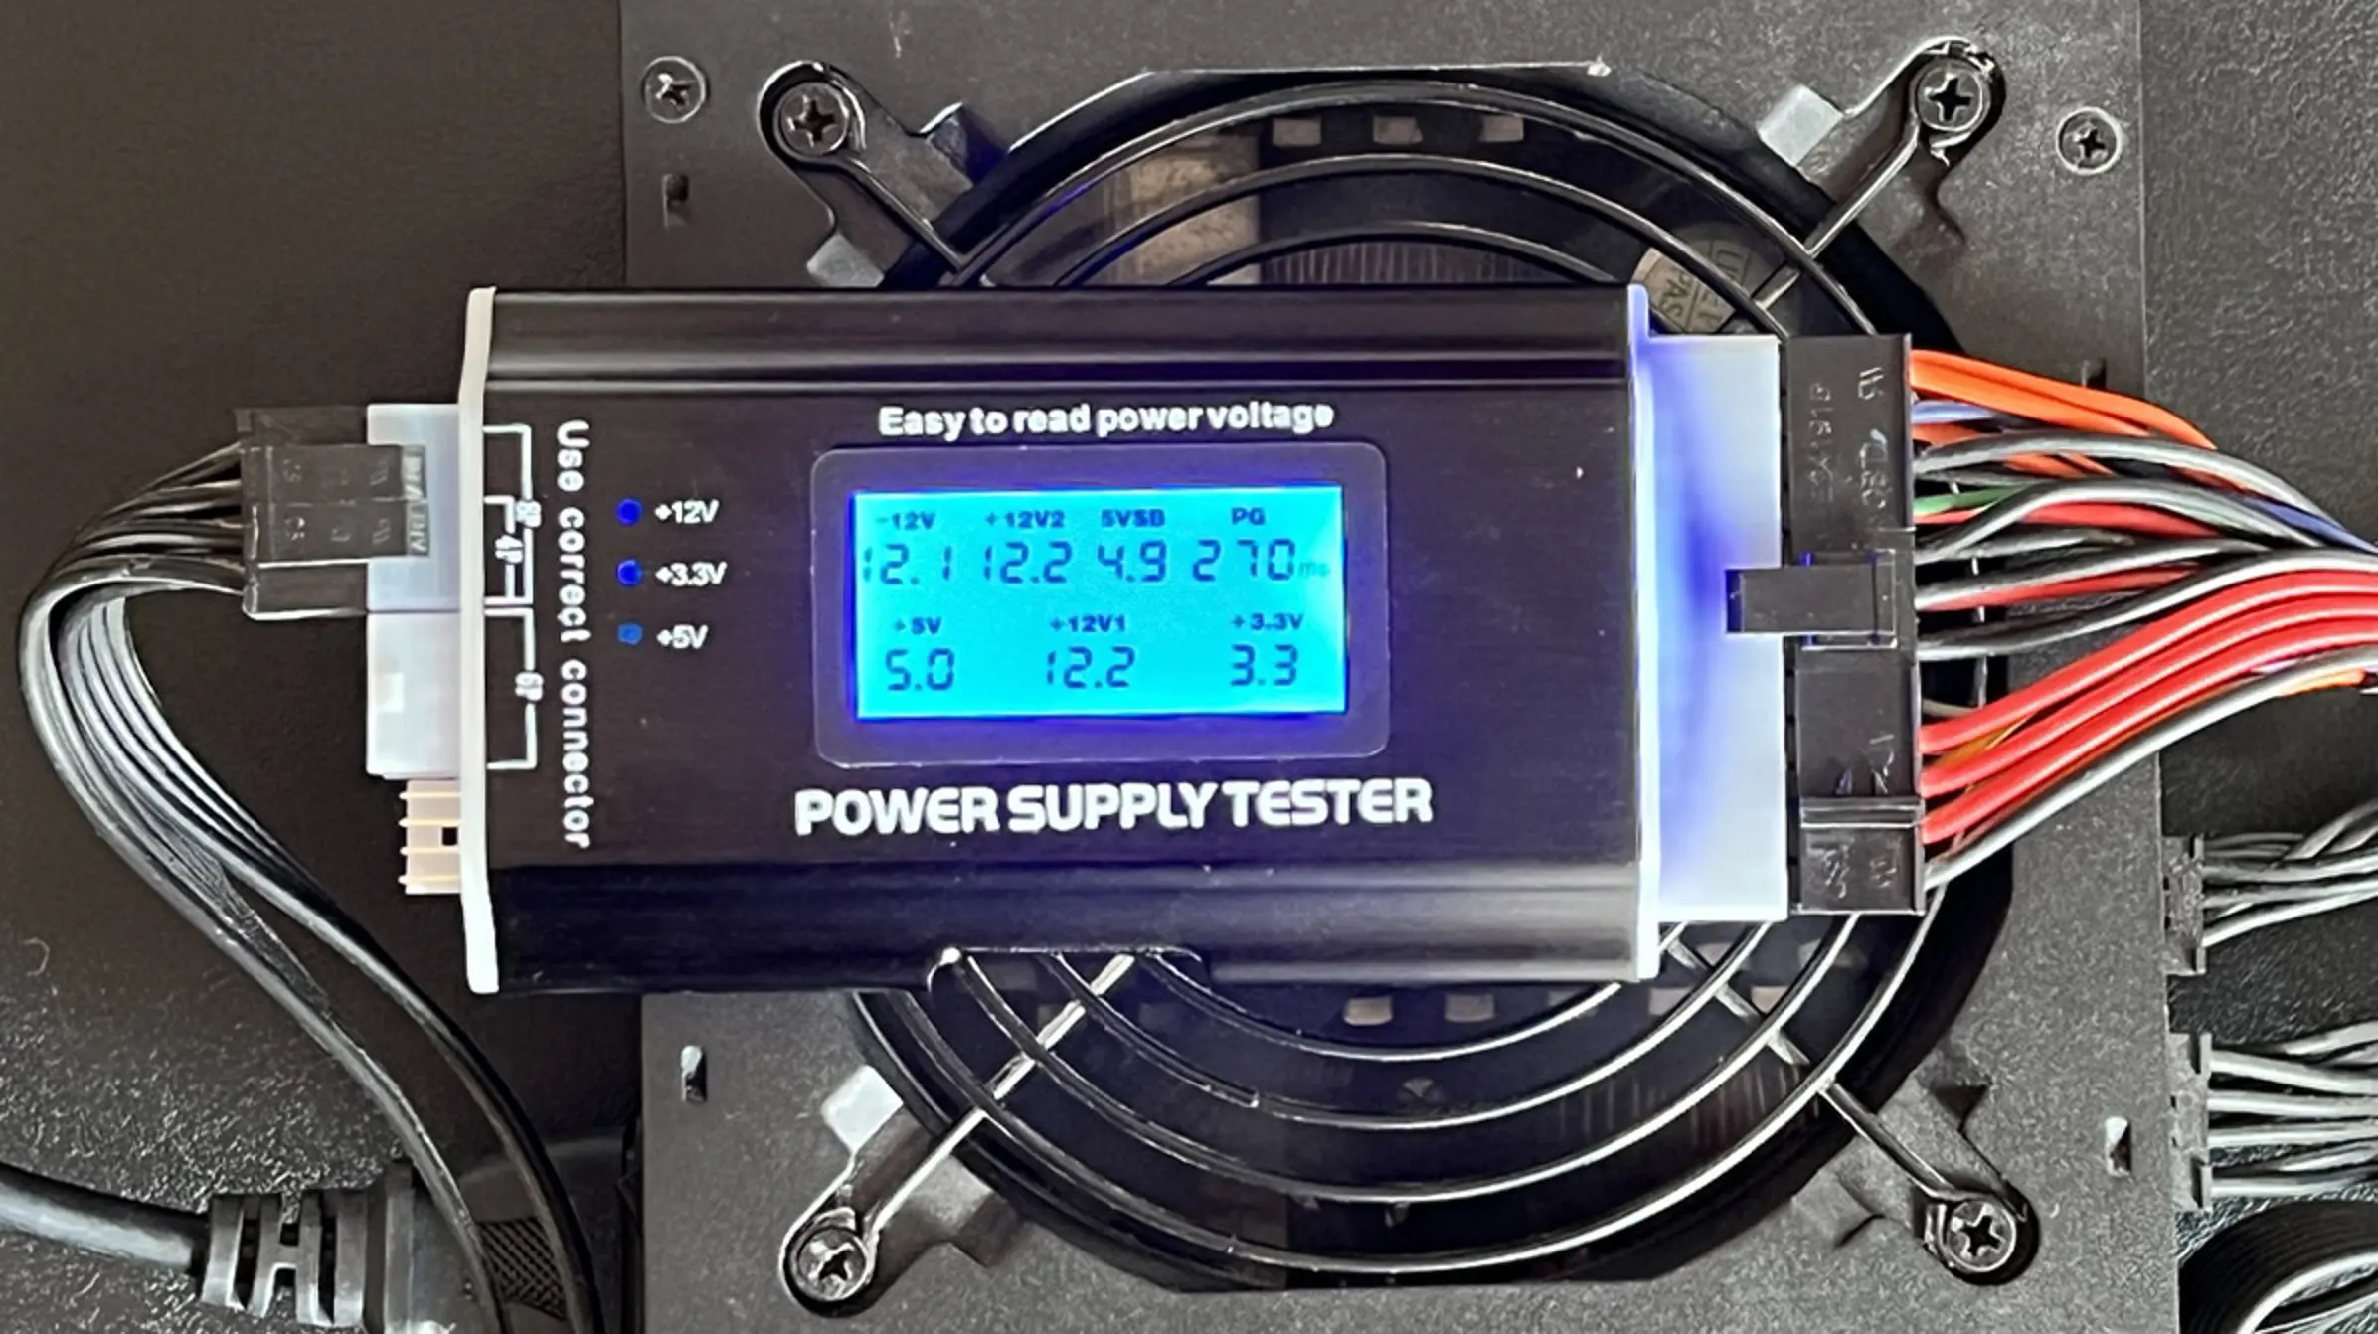
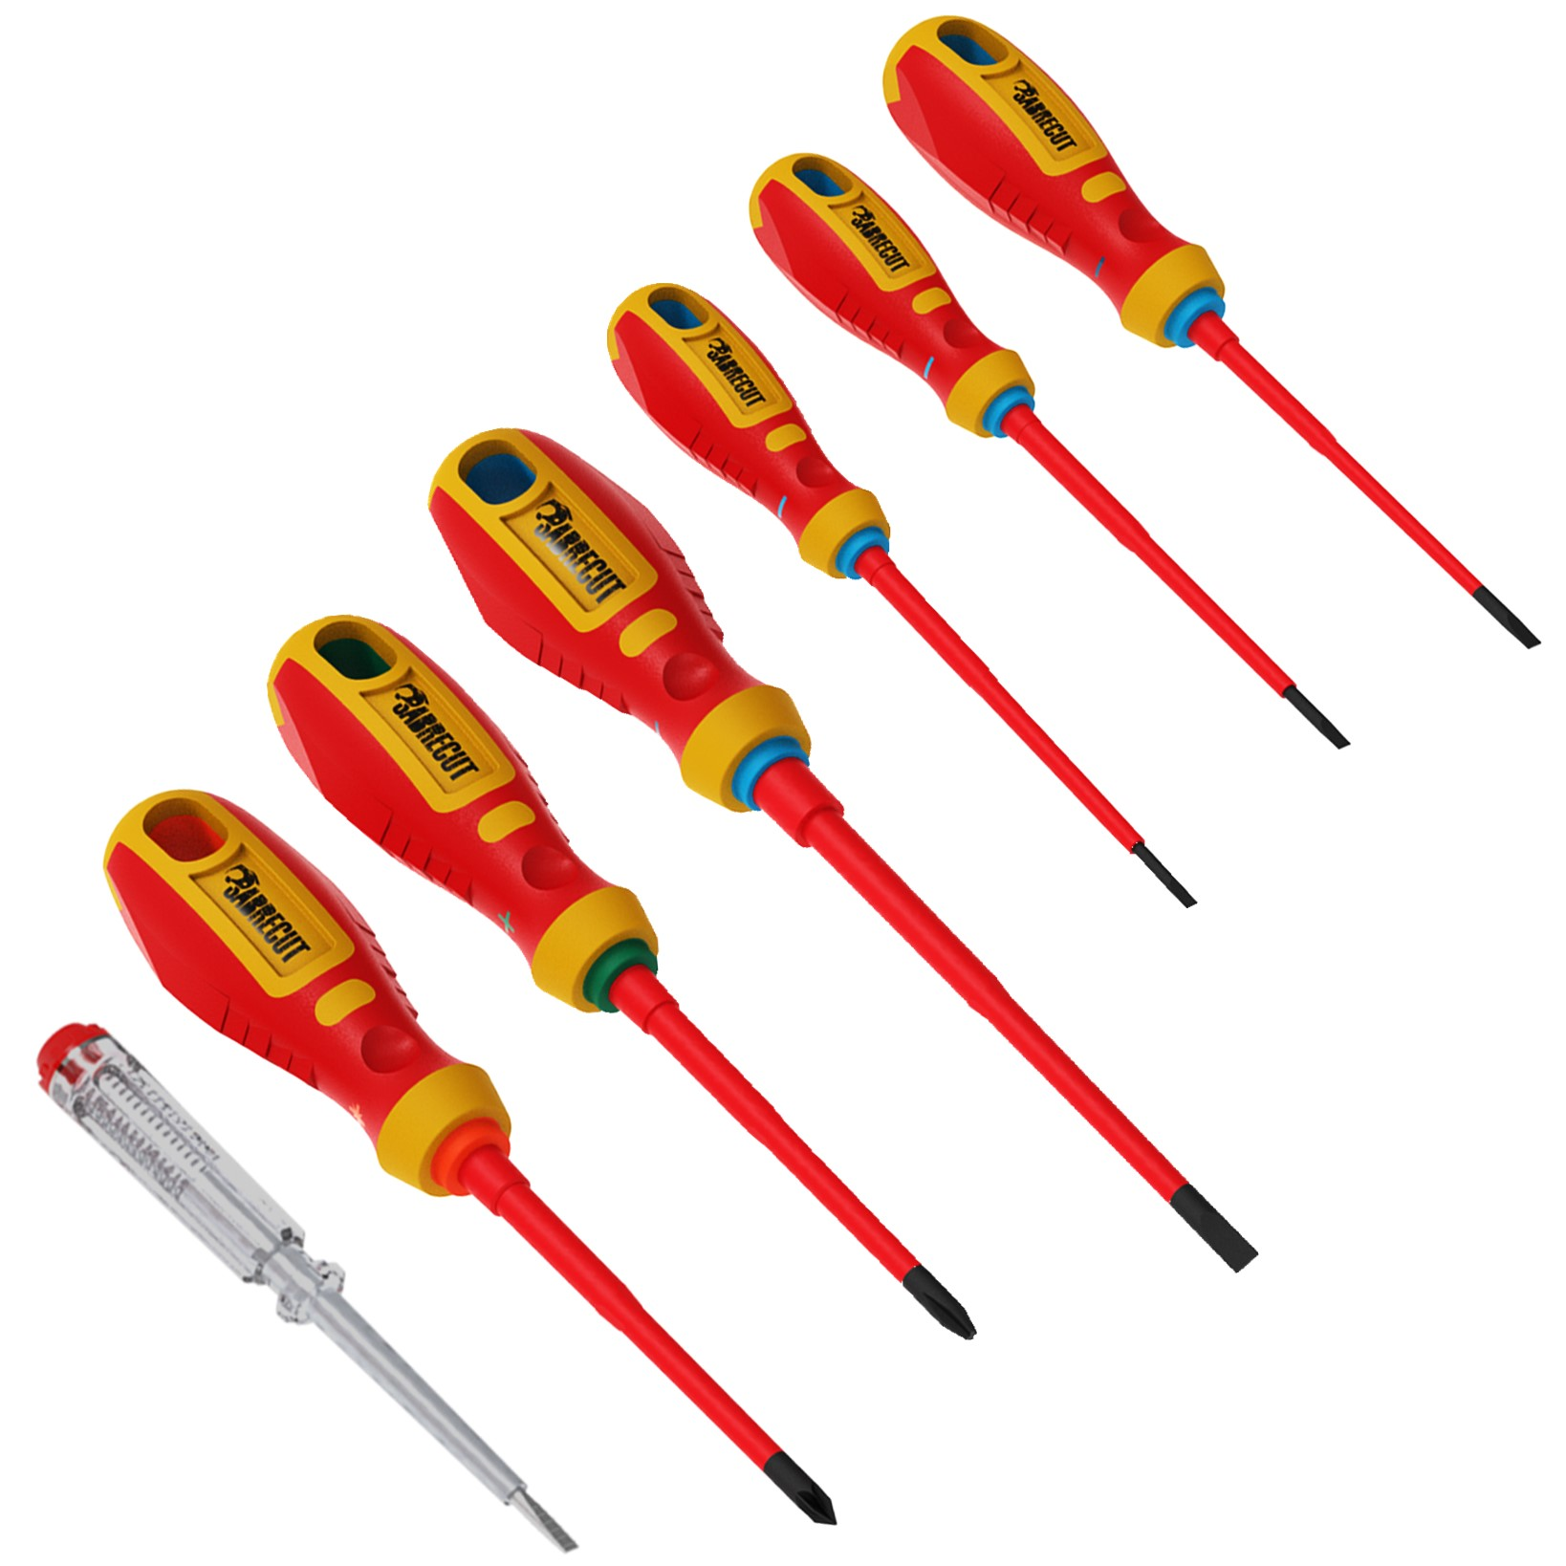
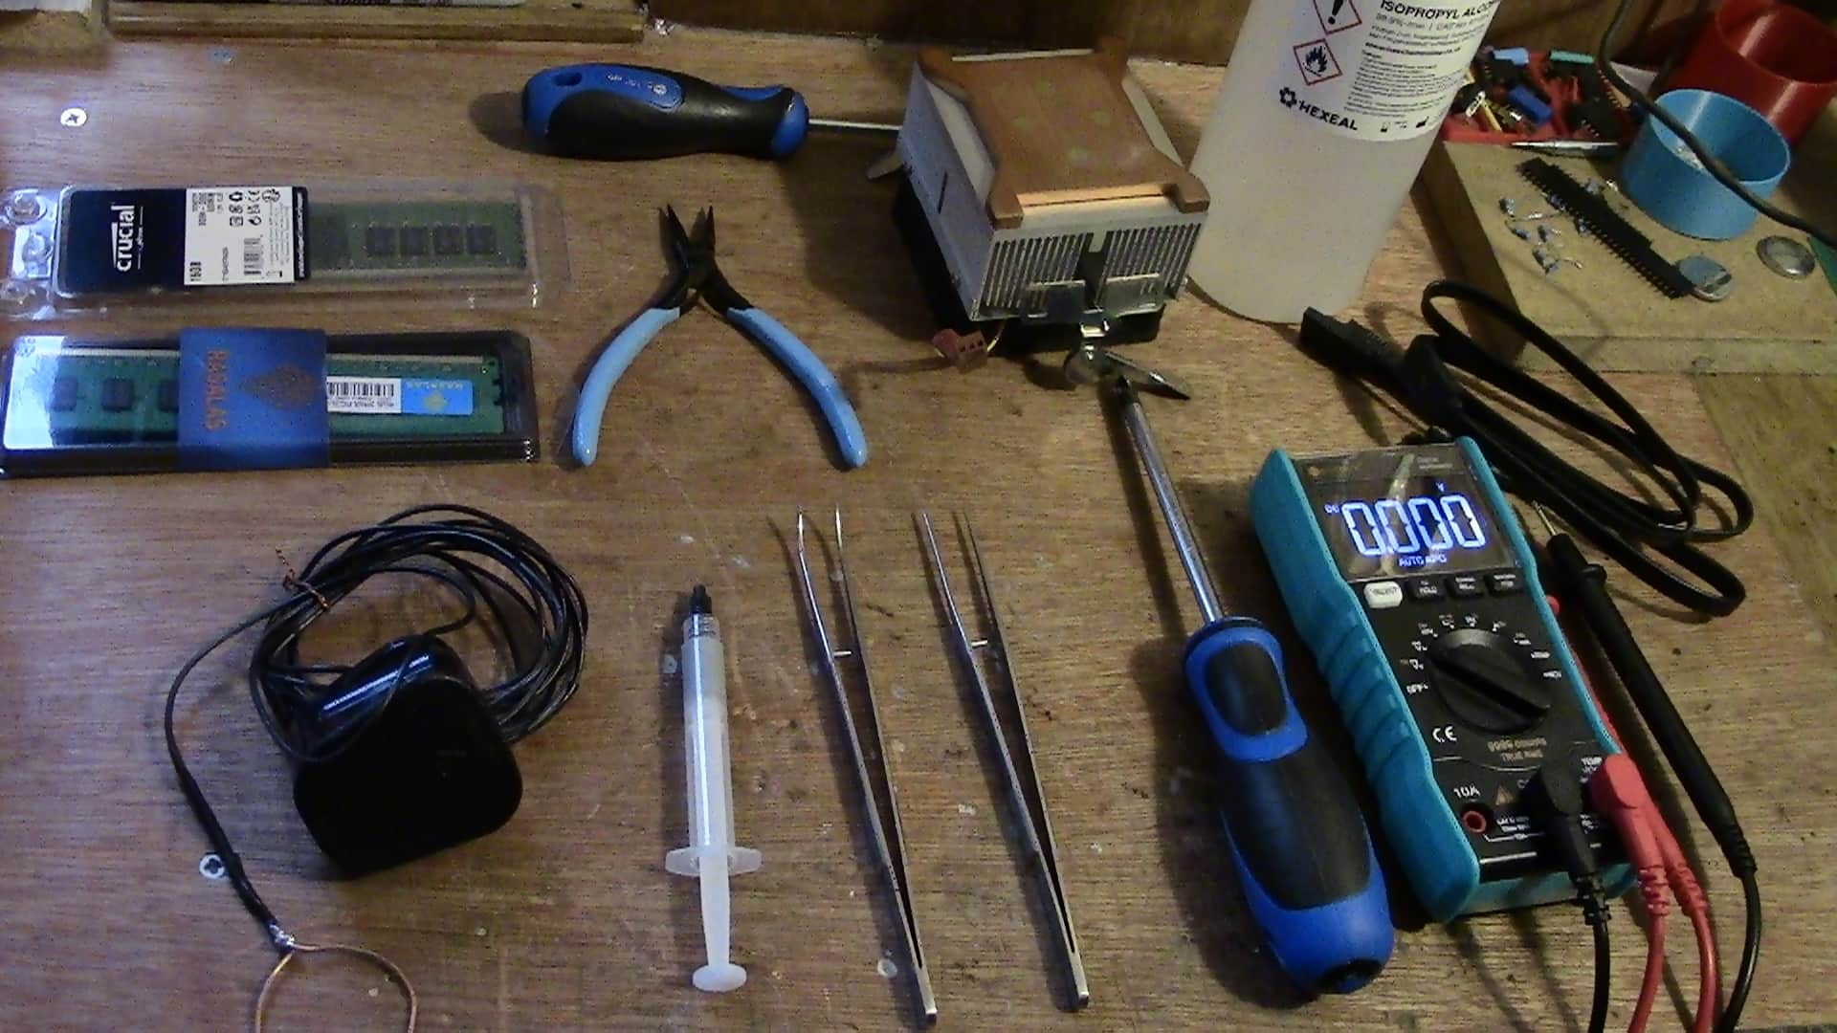
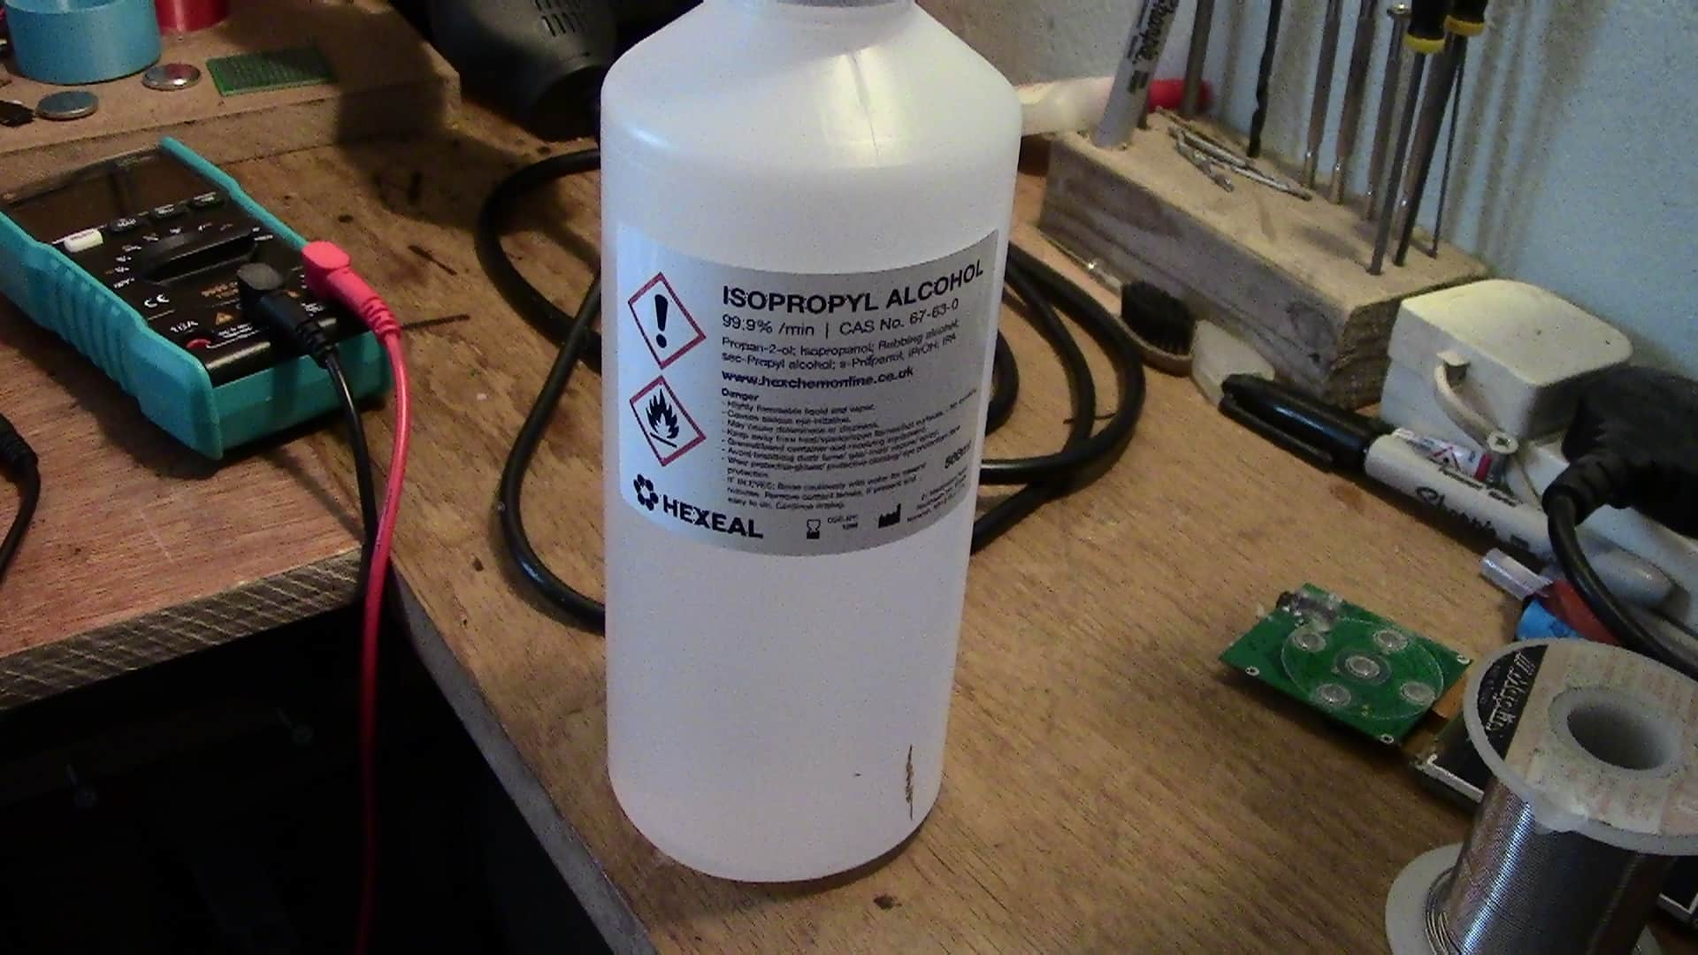
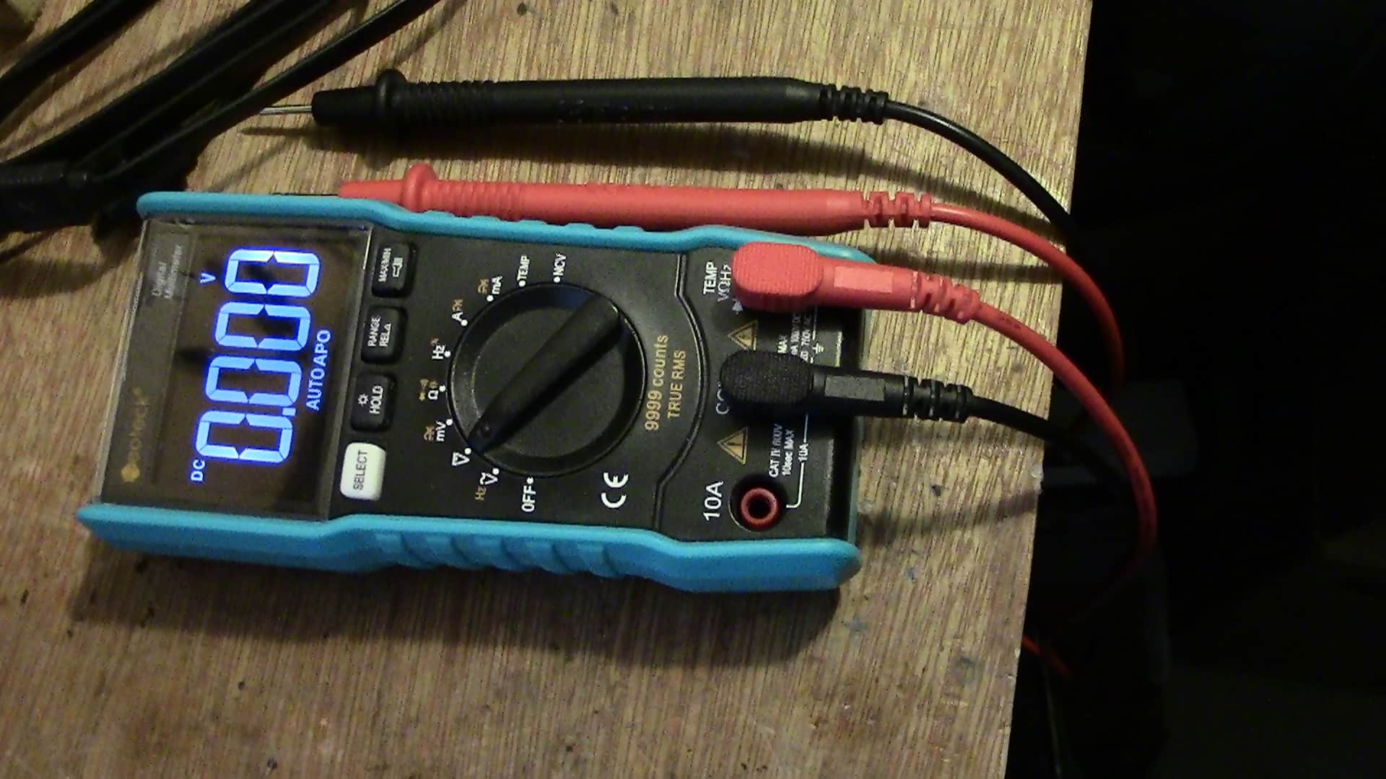
Tools for computer dismantling and maintenance
When dealing with electrical components it is necessary to use the correct tools.
An Insulated screwdriver should be used when dealing with electrical components to prevent anything from being shorted or damaged, insulated screwdrivers should be used when installing motherboards power supplies or hard drives because they protect the components from electrical damage.
A power supply tester should be used so you can check the power supply for incorrect voltages, so it does not damage the rest of the system.
It does this by monitoring the output and checking to see if the voltages it reads of what they should be and then it will indicate whether the power supply is still working or not with the LED's or screen.
A digital multimeter it's a tool to test electrical values and to diagnose circuits and components. most digital multimeters we'll measure, volts, amps and ohms.
Isopropyl alcohol is used for cleaning electrical components and systems because it leaves no residue and does not damage electrical systems and it's not corrosive.
link to source
link to source
sertgrg
fhdd
Hire is the screwdriver I used for assembling the computer.
I used this thermal paste for installing CPU.
This is a multimeter I use this for testing components and voltage values were assembling the computer.

Slide 3
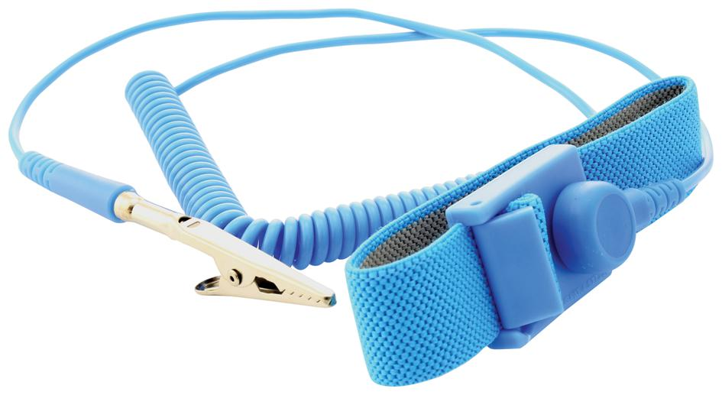
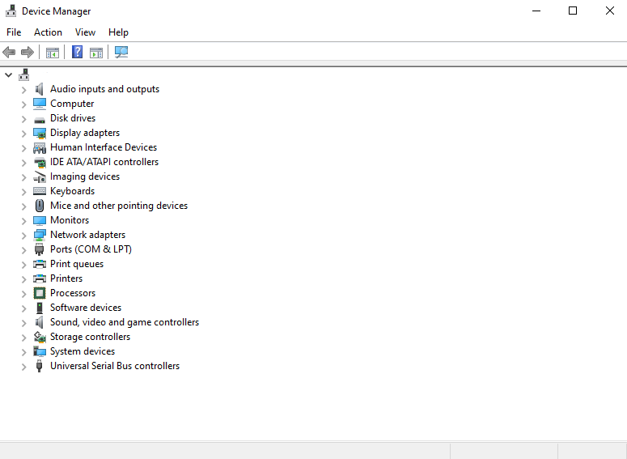
Tools for computer dismantling and maintenance
Anti-static wrist straps are used to safely ground the user, so they do not electrocute themselves or any electrical components from ESD or electrostatic discharge. It is important to safely ground people working with electrical components because of static buildup. people working with the system can damage components when discharging through them.
The device manager is an inbuilt tool in the windows operating system, it displays all the devices currently installed in the machine and can be used to diagnose problems, if a hardware device has stopped working it will show up in the device manager for the user to see. The device manager can also be used to check for updates to drivers or disable or uninstall drivers, it can also be used to disable and enable devices in the system.
link to source

Slide 4
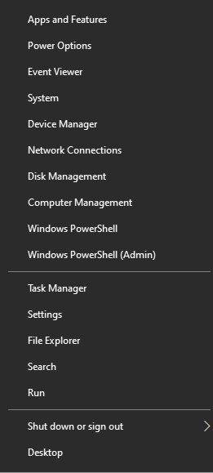
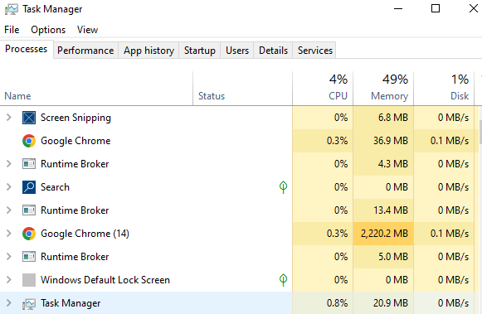
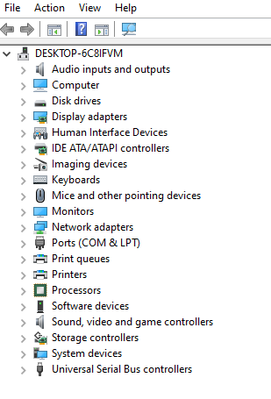
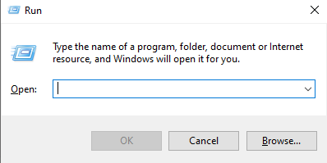
Tools used for computer software analysis and management
If you press windows X, you will bring up a bar with lots of useful tools.
Task manager
Task manager displays all the current tasks being done by the computer and how much CPU ram or desk it is using so you can see how well your computer is performing with different software's.
Device manager
Device manager is used to enable devices and managing what is in your computer.
you can view all your peripheral devices and enable and disable speakers or GPUs.
Run
Run is a useful piece of software in windows, used to run software's, including MSConfig and many others that can be used for disk defragmentation and scanning for viruses or harmful software's on the system.

Slide 5
These are my two clients.
1 Michael page company upgrading computer systems.
2 ideas with Africa decommissioning old systems.
This is what I am going to do
the first thing I'm going to do is backup all important company data.
I'm going to decommission the old systems to IT schools Africa but retain the old SSD drives and install them in the new system that haze greater storage capacity and keep the speed benefits of SSD drives.
Installing extra devices like scan and Nic card.
Test everything to make sure it works.

Slide 6
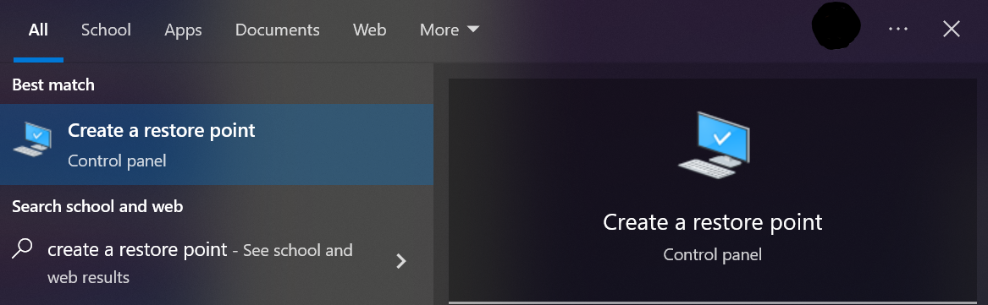
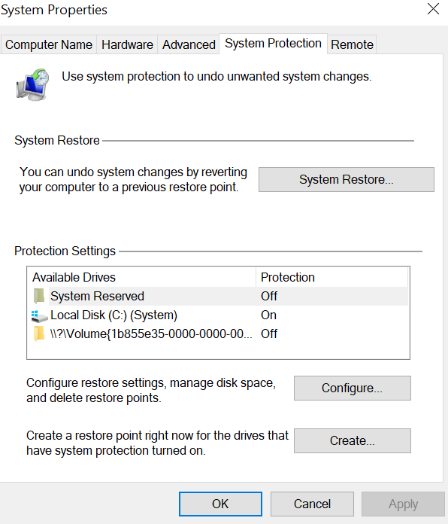
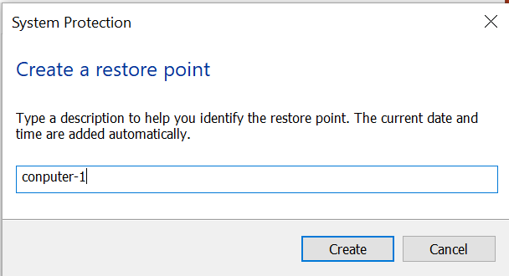
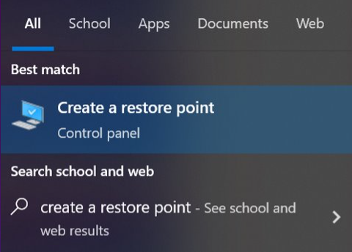
Backing up files safely
I can yose create a restore point in windows to everything is stored on the system including preferences and files.

Slide 7
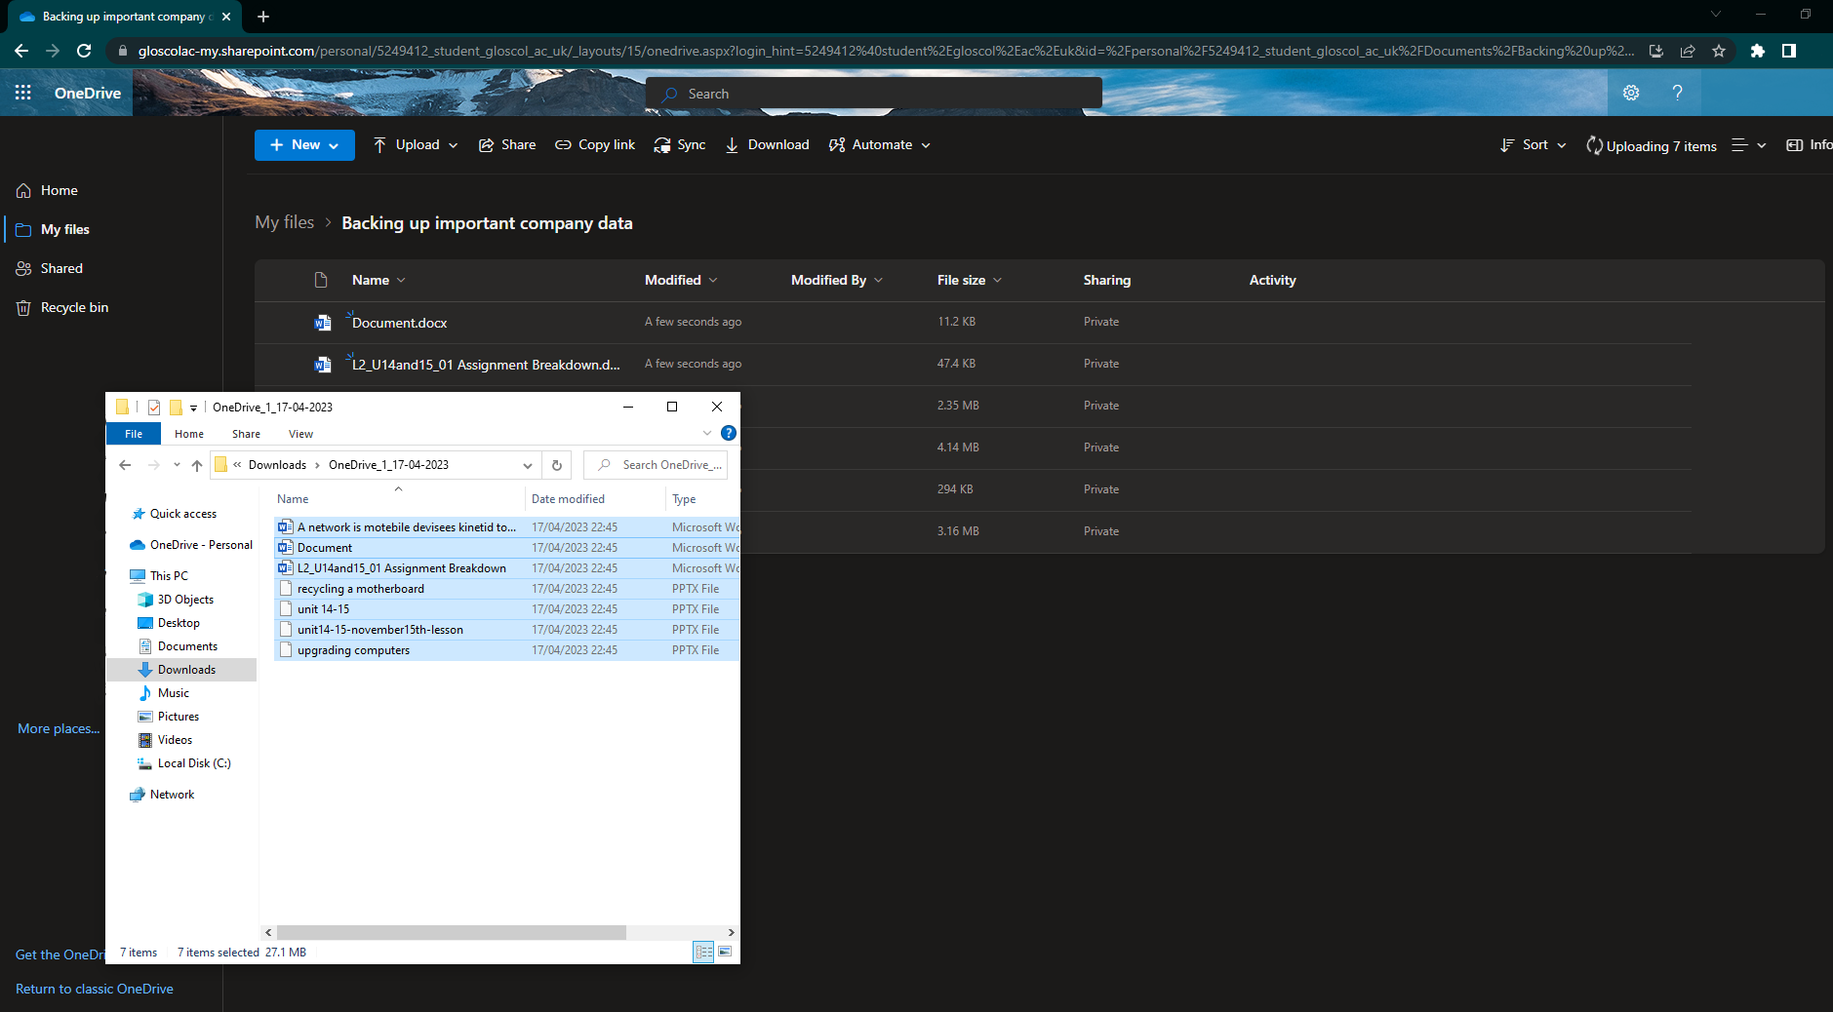
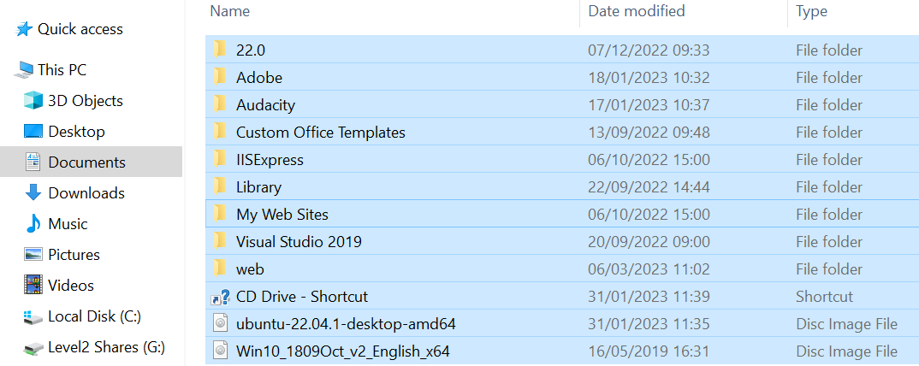
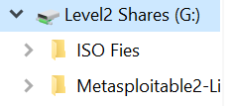
Action plan Job
Job description ​​ | ​Work required ​​ | Expected result ​​ | Actual result | Constraints ​​ | ​Additional remedy ​​ | ​Comments ​​ | Time require
​ backup four important company data.​ ​ ​ | ​back up the previous data to an external drive or a USB stick just in case there are any problems with installation in the new system. ​ | ​​ ​ files should be safely backed up to drive for USB stick check before removal of the drives.​ | All data was backup up safely too online storage and extra backup drives. | ​​ ​ transferring the files to an external drive will take time this will probably have to be done outside of work hours.​ | ​​ ​ on a backup drive or USB stick as back up to the drive, Because the data is very important.​ | ​ the reason I've chosen to use a drive or USB stick it's because I cannot use online storage because of the lack of Internet connection so it is the only option.​ | ​​ this took quite a while because of the lack of a Internet connection in the office I needed to hotspot from my mobile device. ​​
I backup all important company data to OneDrive,
I backup all important company data to a second drive,
I created a restore point using
create a restore point in windows. This creates a restore point if any of the data is corrupted or lost.

Slide 8


ACTION PLAN JOB
​Job description ​​​ | ​Work required ​​​ | Expected result ​​​ | Actual result | Constraints ​​​ | Additional remedy | Comments ​​​ | Time require
decommission the old systems.​ | SSD drives would have to be added because the old ones have been kept. Also installing Linux and other usable software for IT schools Africa like Python.​ | installation of these software's for the decommissioning of the machines should be straightforward and successful it should all be good.​ | The systems were successfully decommissioned to IT schools Africa and all WEEE regulations worse sufficiently kept. | it will take up a lot of time to install these software's on each computer.​ and I will have to follow WEEE regulations for the decommissioning process. |  |  | ​​​ ​​​
I successfully decommissioned all the old systems too IT schools Africa.
I was able to follow WEEE regulations with the decommissioning process.

Slide 9
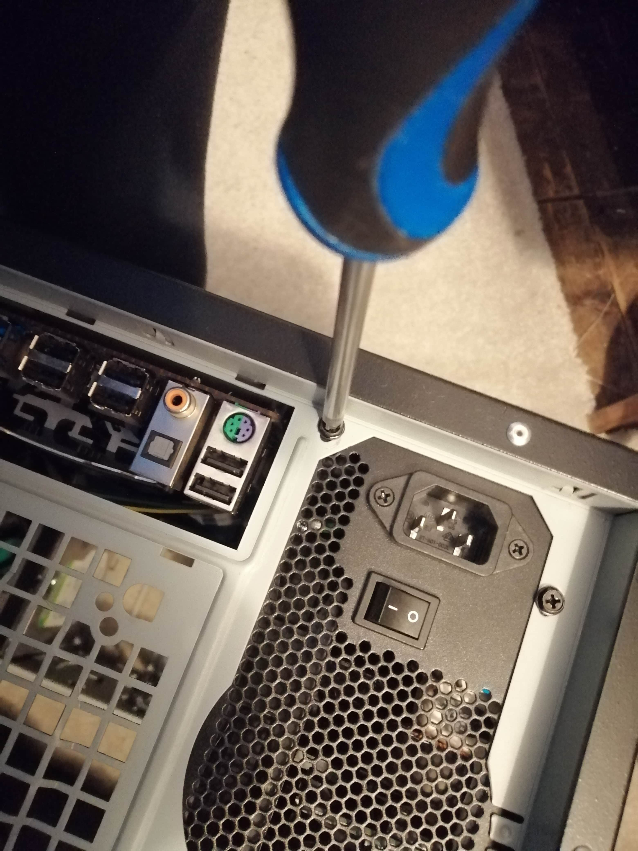
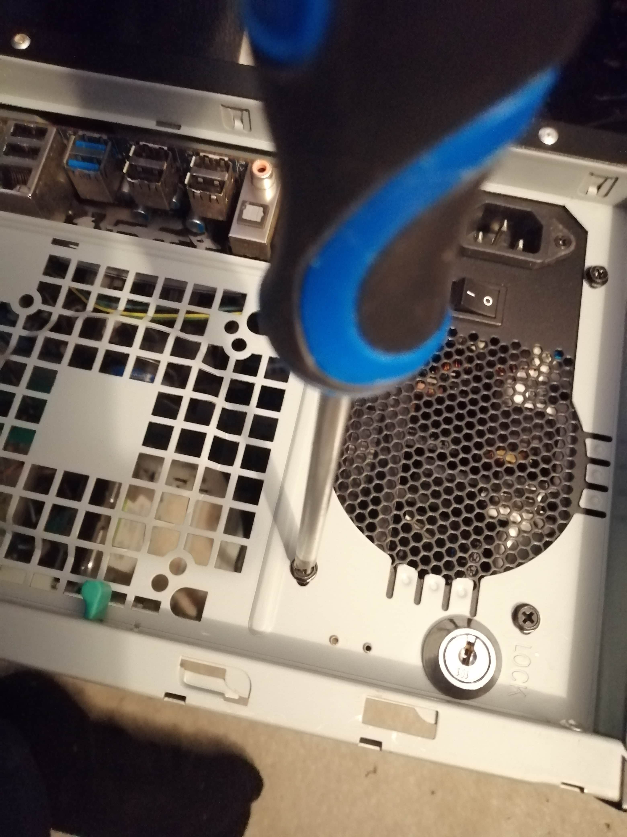
ACTION PLAN JOB
​Job description ​​​​​ | ​Work required ​​​​​ | Expected result ​​​​​ | Actual result ​​ | Constraints ​​​​​ | ​Additional remedy ​​​​​ | ​Comments ​​​​​ | Time require ​​
Installing the PCU in ​case of new meshes. ​​ | ​ screwing the power supply in and making sure it is lined up with the case correctly. | ​​ a correctly installed power supply which is working and correctly lined up with the case. | ​​ the power supply was installed correctly, and it's lined up with the case and working correctly. | ​​ | ​​ | ​​ | ​​
Hir, I Installing the PCU in the case, I did not use a insulated screwdriver for this process although it would be good it is not necessary for external jobs outside of the system because the possibility of shorts a much lower especially without the system being plugged in.

Slide 10
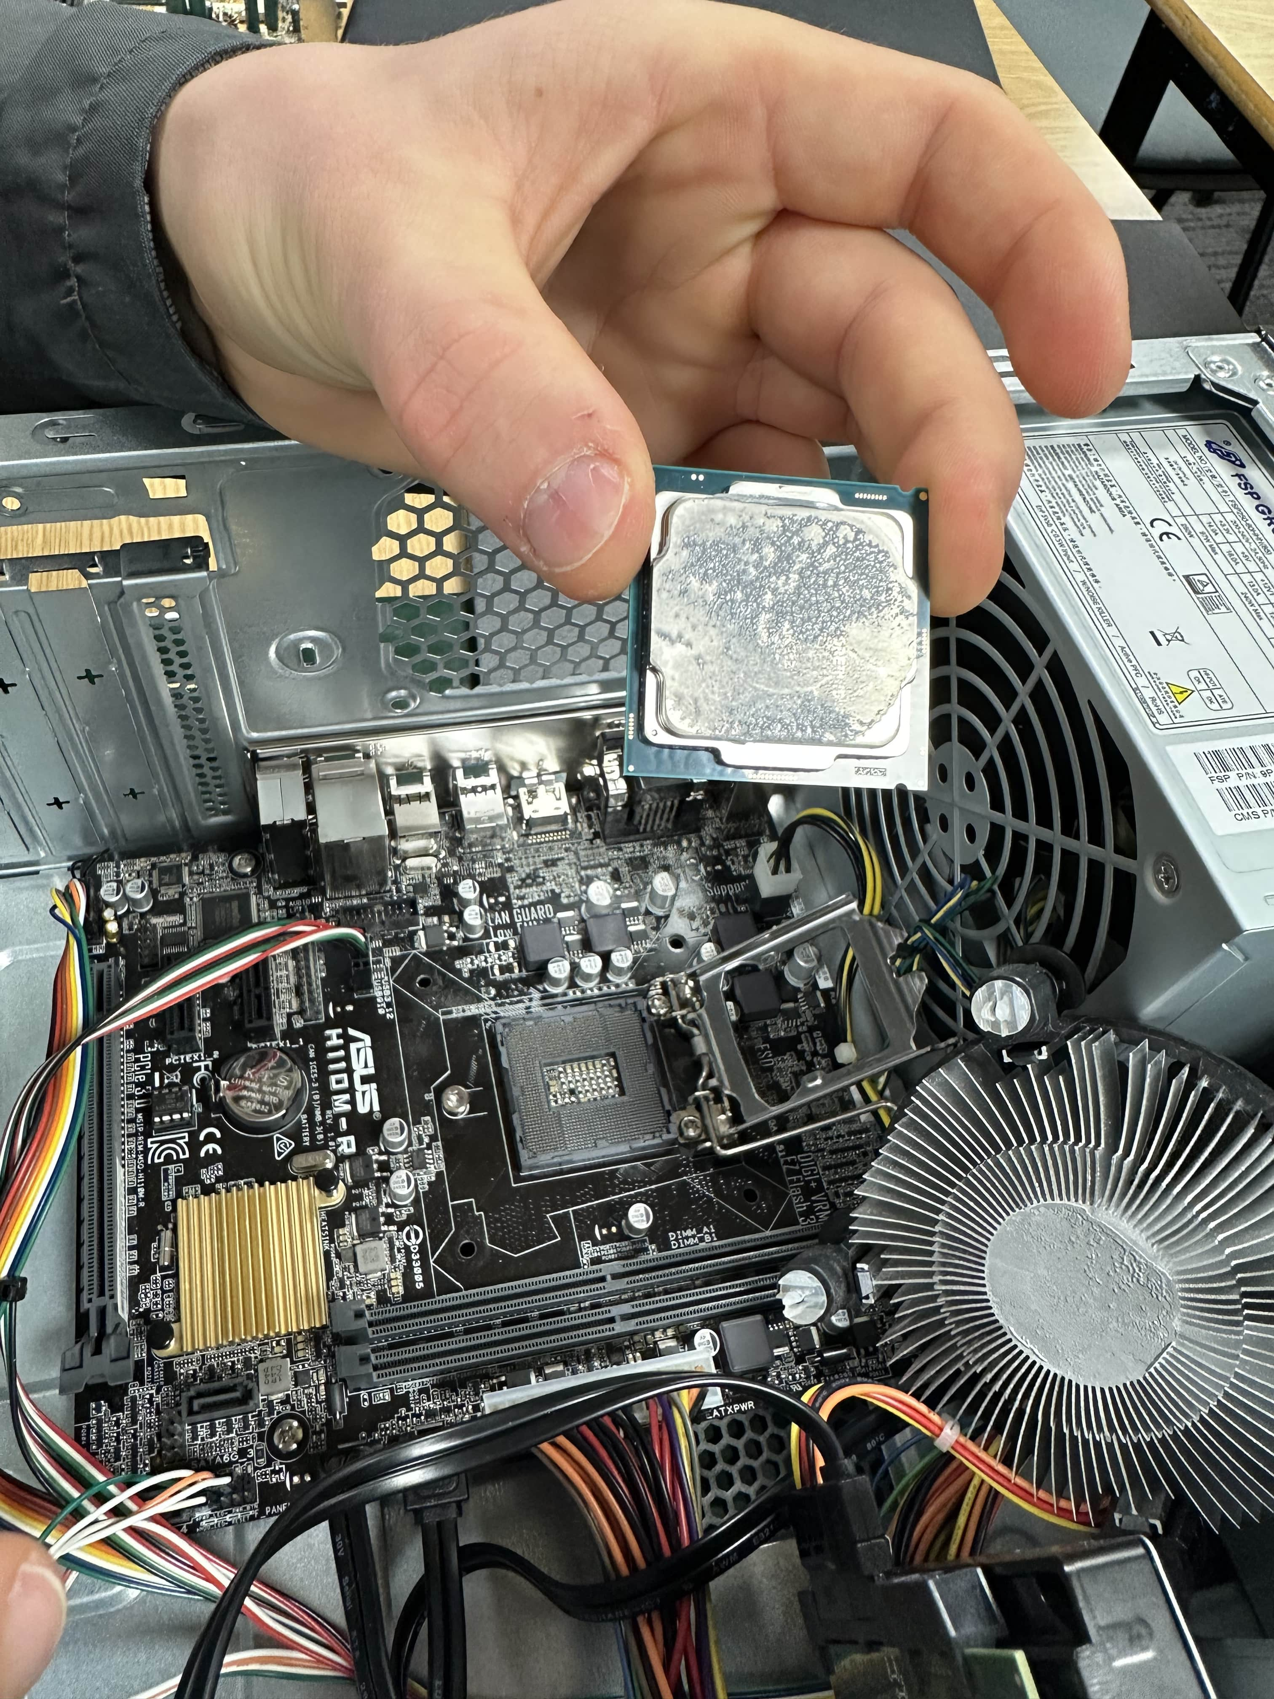
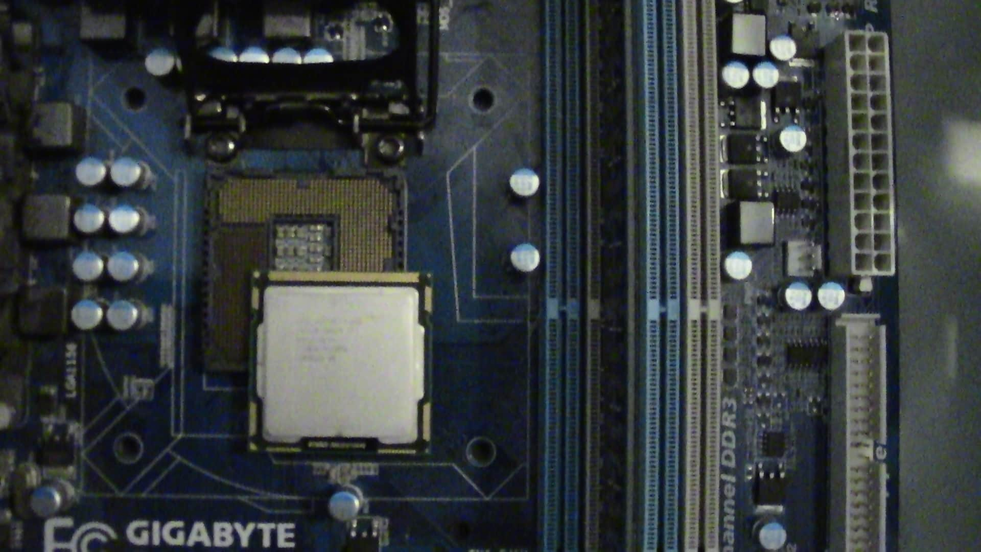
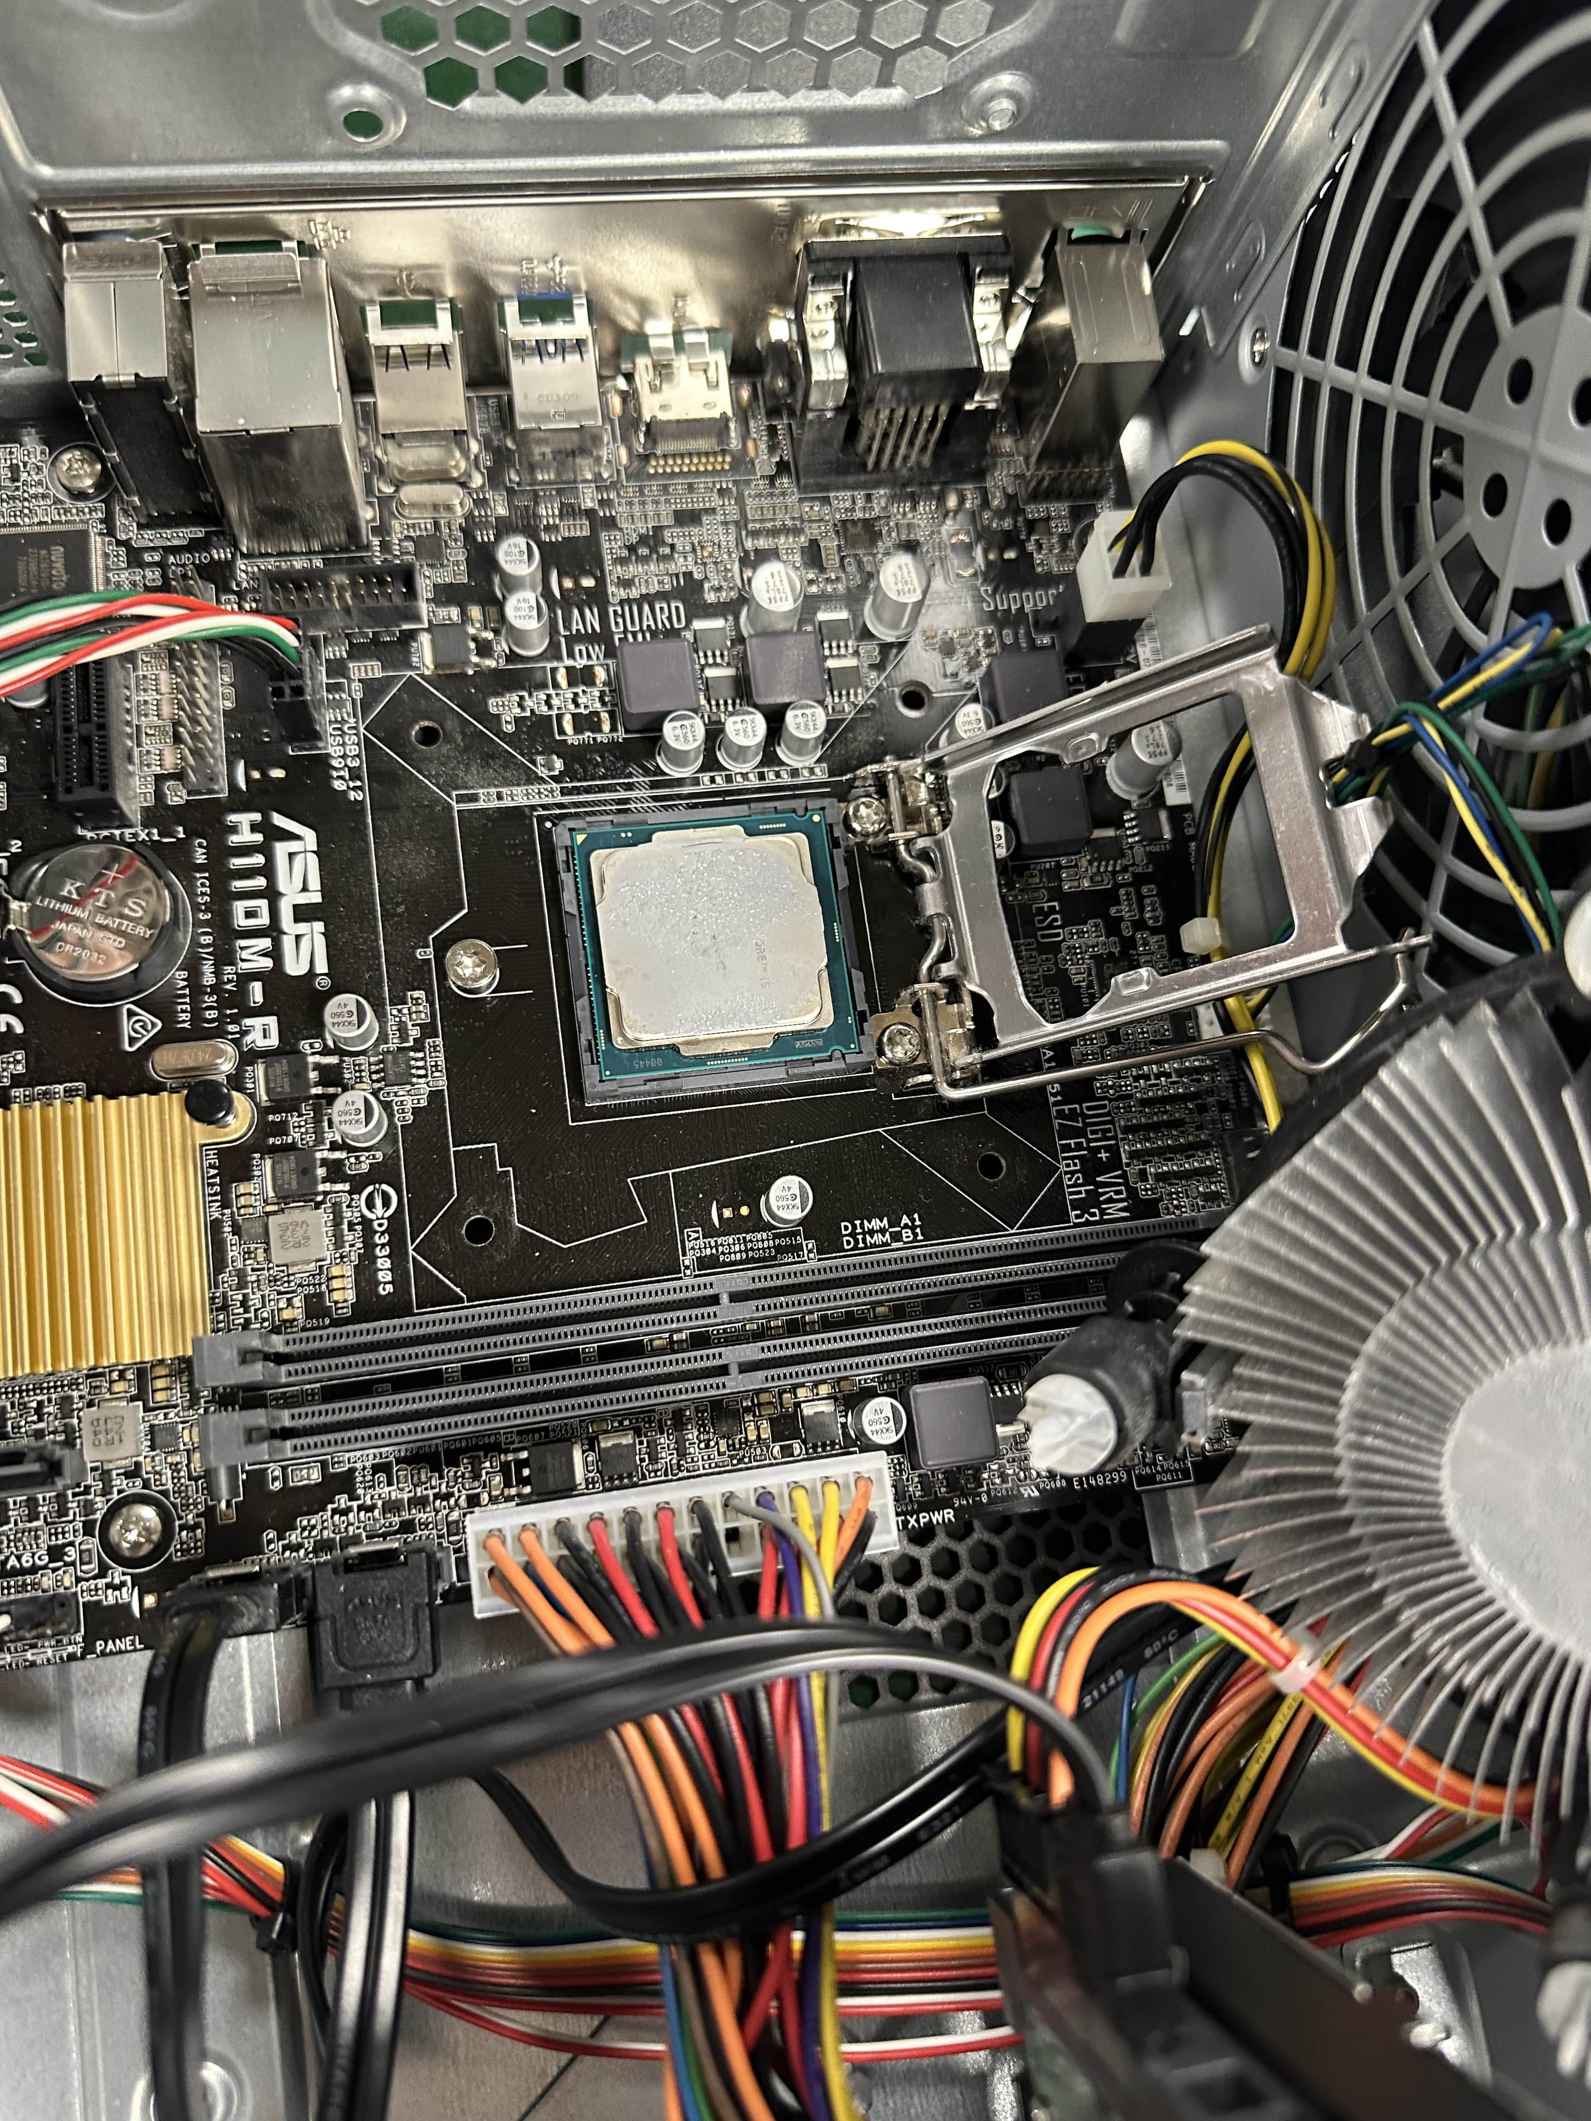
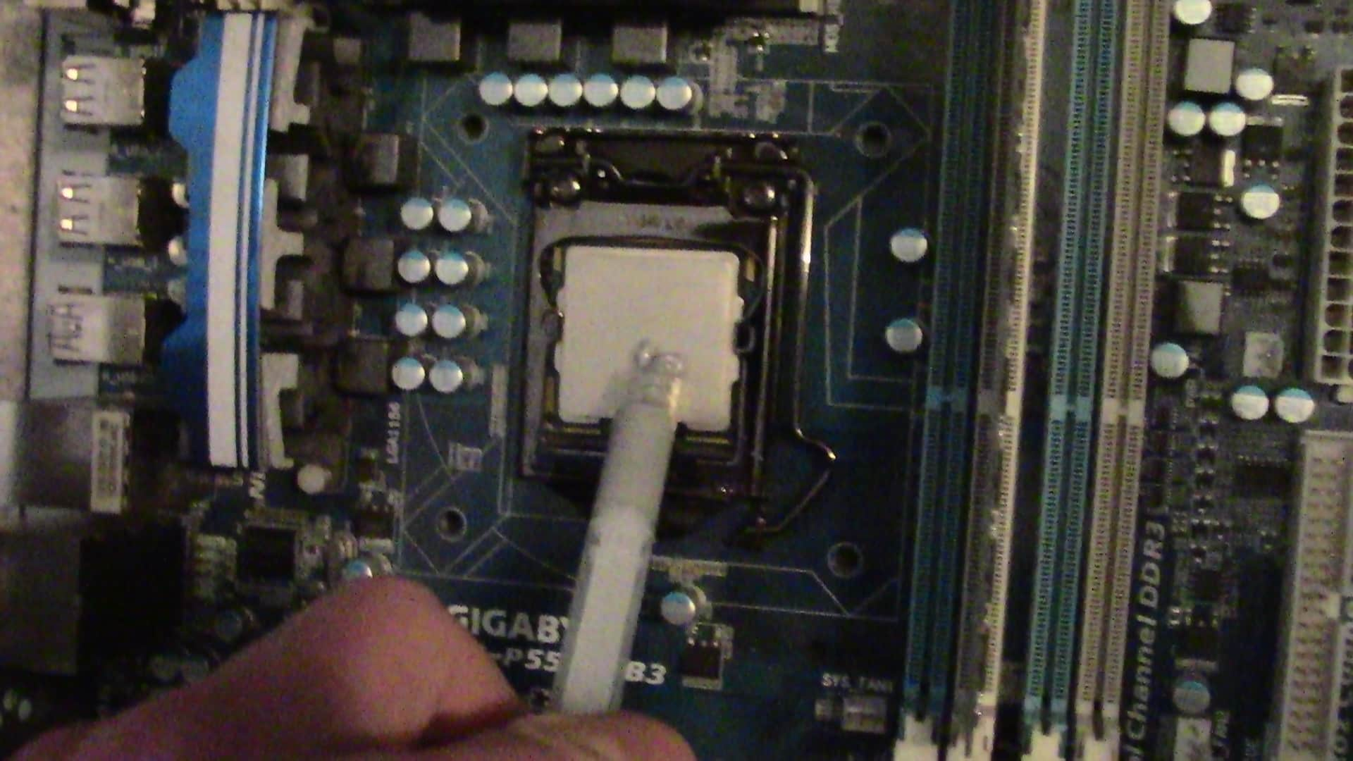
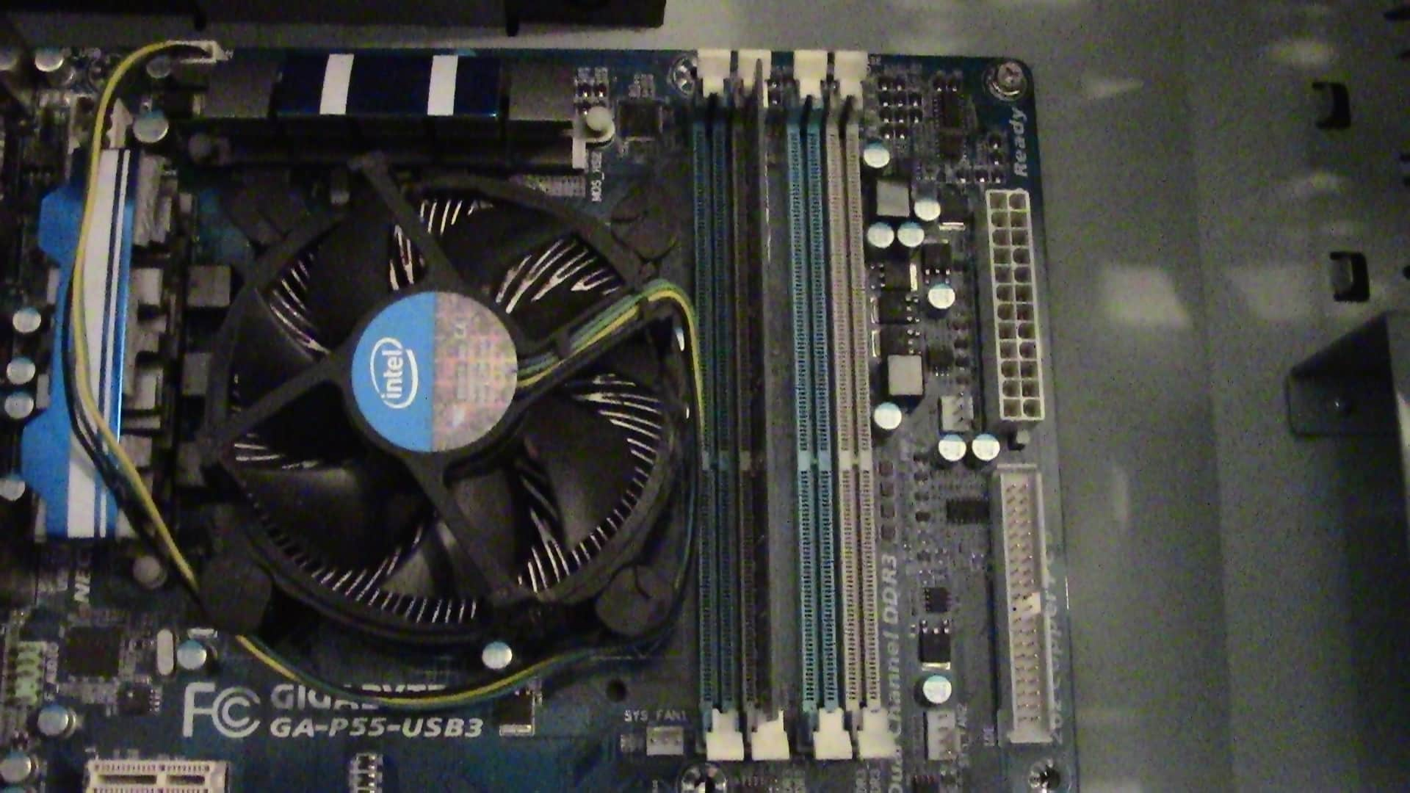
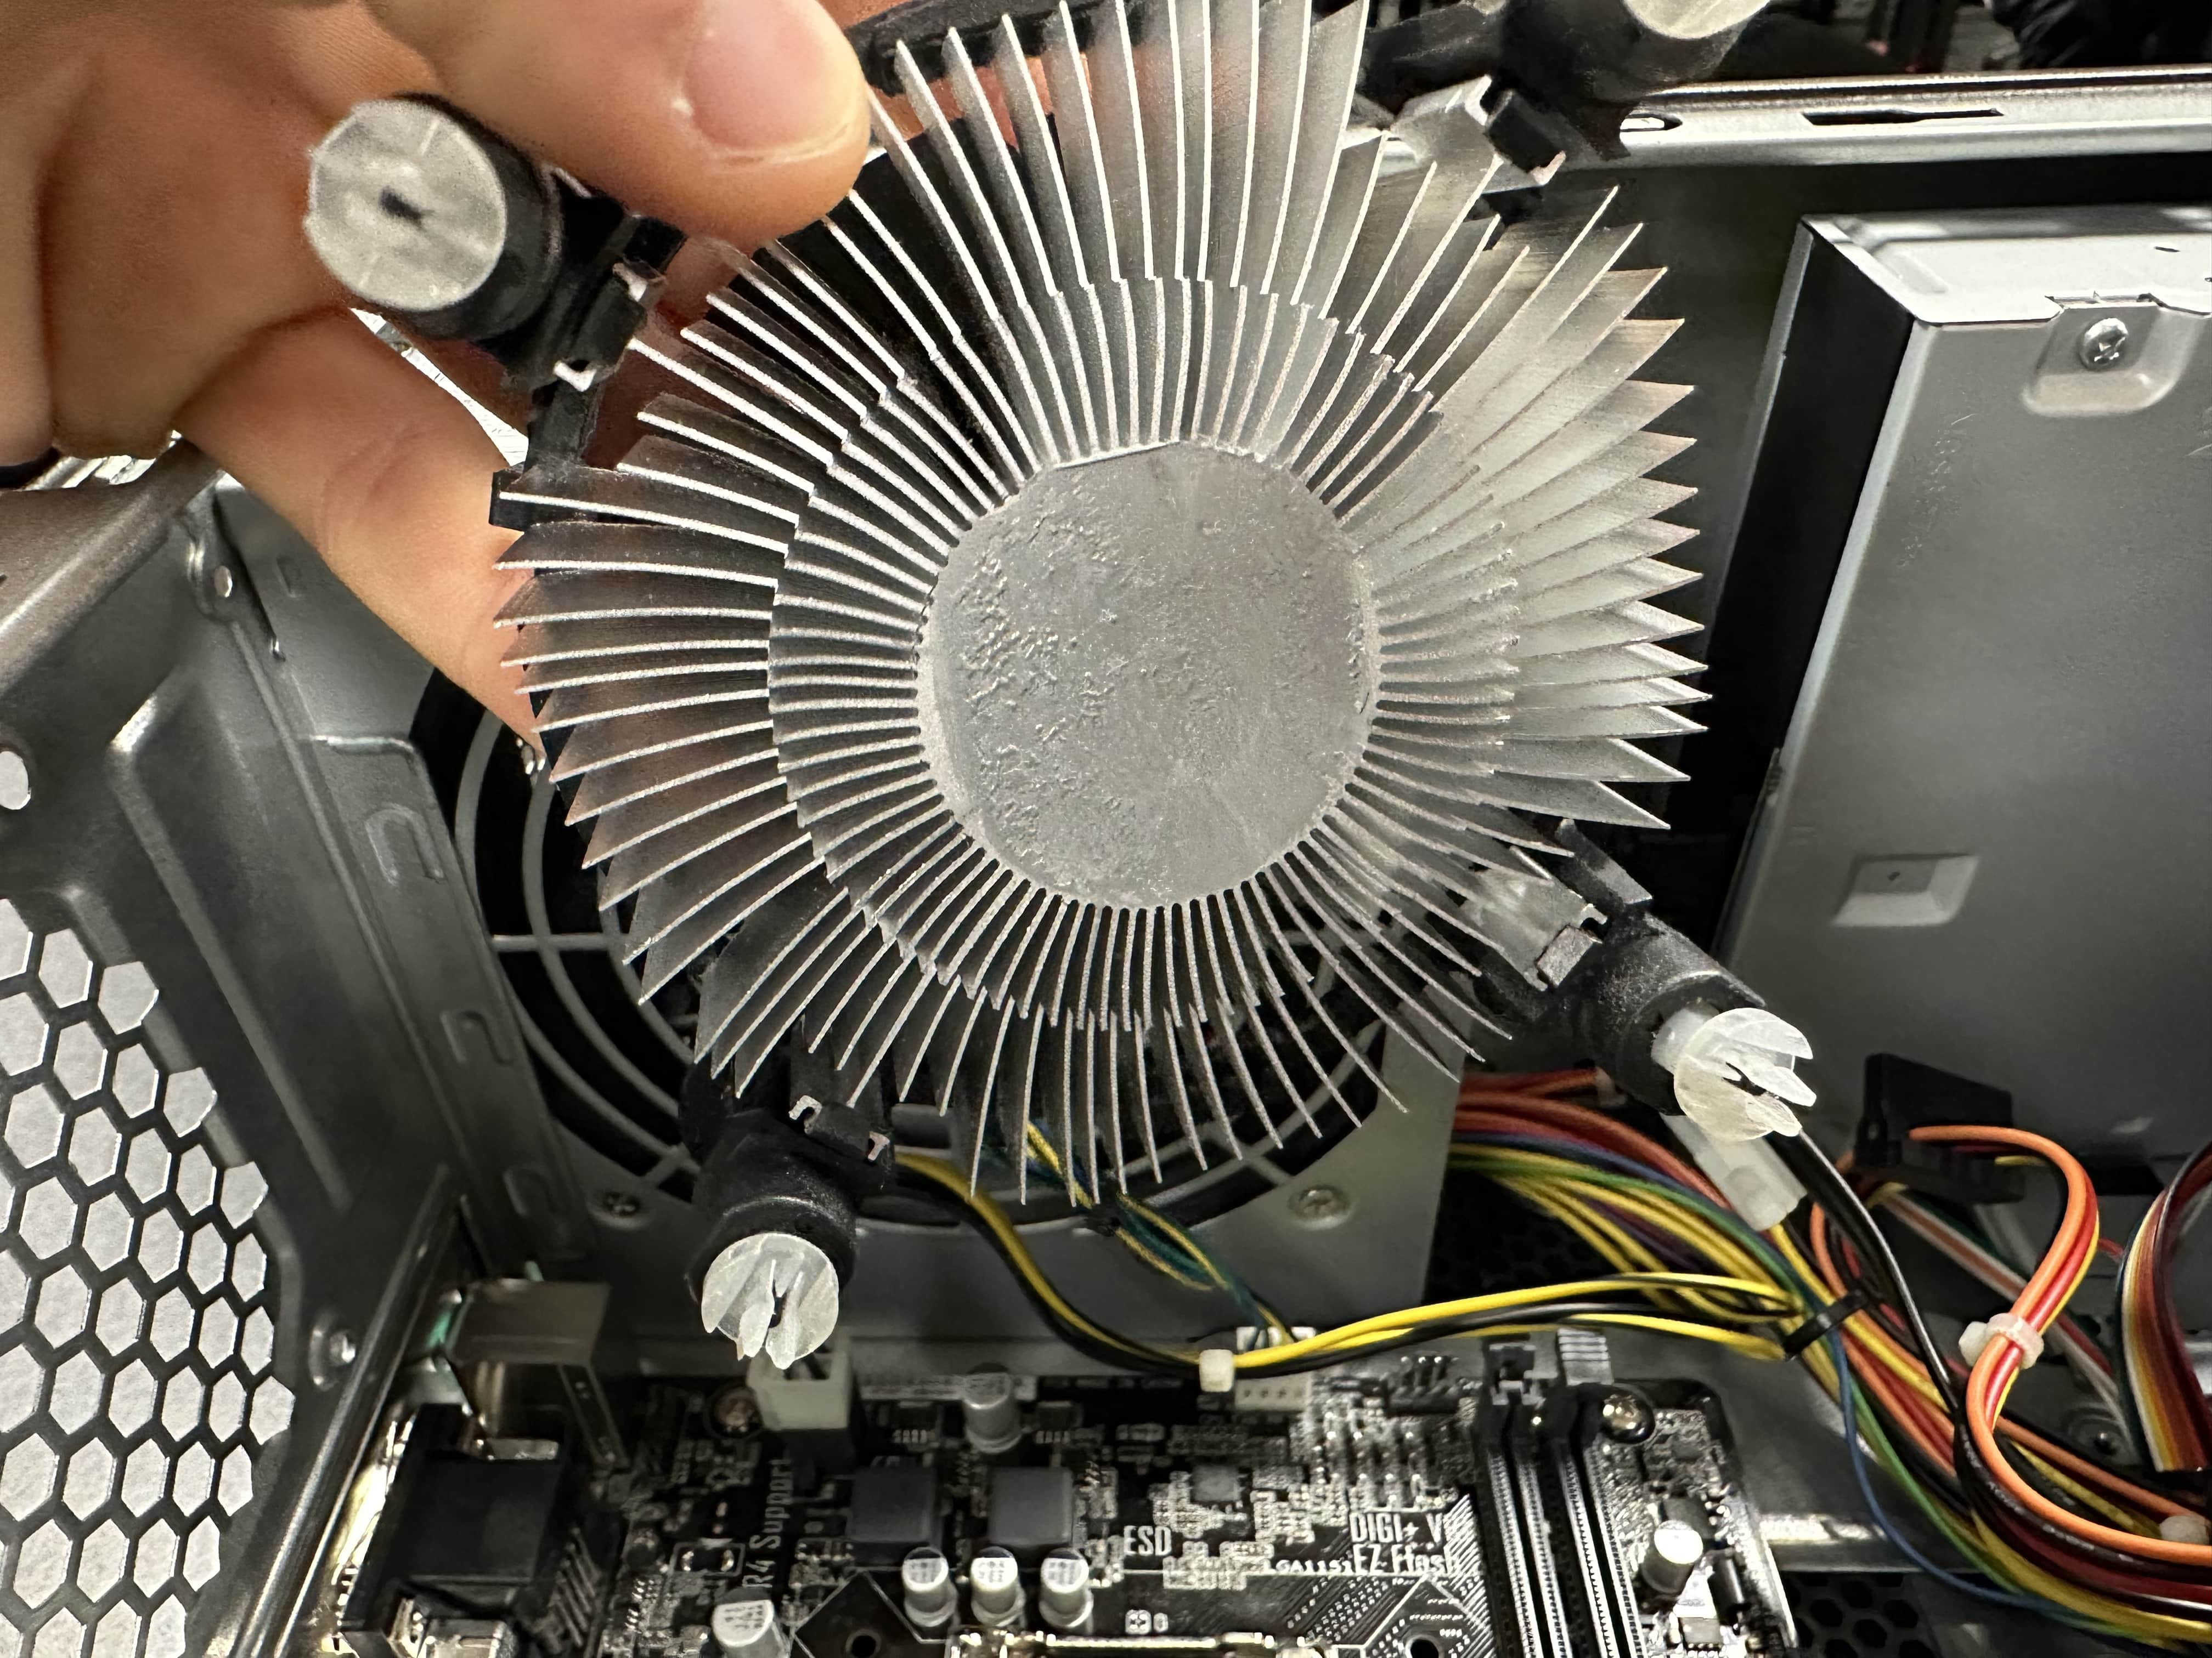
ACTION PLAN JOB
​Job description ​​​ | ​Work required ​​​ | Expected result ​​​ | Actual result | Constraints ​​​ | ​Additional remedy ​​​ | ​Comments ​​​ | Time require ​​​
Installing CPU In new motherboard | Replacing the CPU in the socket on the motherboard well checking form bent pins, installing thermal paste and the cooling block I'm plugging in the fan. | I would expect a correctly installed CPU with no overheating or performance problems. | the installation of the CPU was successful with their hiccups or problems. | I needed to handle the CPU carefully because it's very delicate piece of computer hardware. |  | I need to check the pins on the motherboard to make sure the CPU gets mounted in properly because if one is misaligned it will not function properly. | It should only take a few minutes per computer.
Here I am installing the CPU into the socket in the motherboard.
Here I applied new thermal paste onto the CPU I cleaned the CPU before adding this thermal paste to make sure there are no impurities which could lower heat conductivity.
Instead of the heat sink and fan onto the CPU.

Slide 11
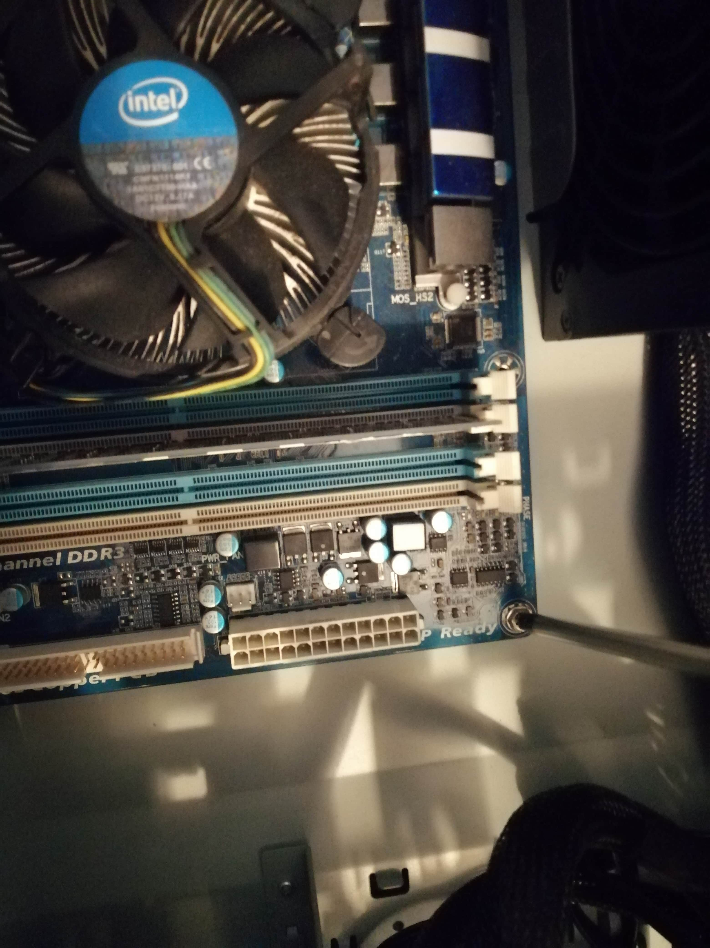
ACTION PLAN JOB
​Job description ​​​​ | ​Work required ​​​​ | Expected result ​​​​ | Actual result ​ | Constraints ​​​​ | ​Additional remedy ​​​​ | ​Comments ​​​​ | Time require ​
Installing motherboard in ​case ​ | ​ The work required is 2 mount and screw the motherboard with a insulated screwdriver and connect power to the motherboard | ​ correctly installed motherboard with no wobble and firmly screwed in. | ​ the move board was mounted correctly, and all the screws were tightened properly. | ​ | ​ | ​ | ​
here I am installing the new motherboard into the case and putting in all these screws.
to make sure I screwed the men properly and not over tightened or not too loose because they could damage the PCB.

Slide 12
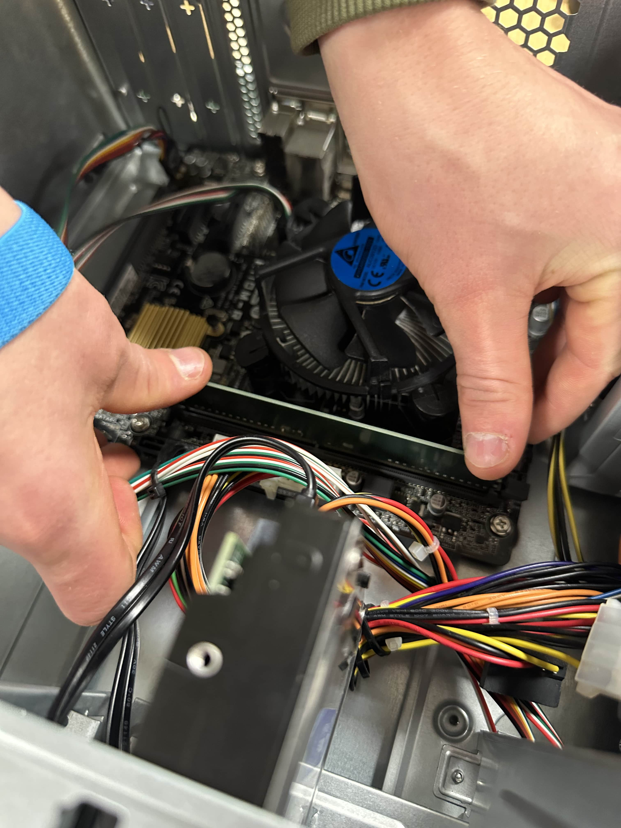
ACTION PLAN JOB
​Job description ​​​ | ​Work required ​​​ | Expected result ​​​ | Actual result | Constraints ​​​ | ​Additional remedy ​​​ | ​Comments ​​​ | Time require
Installing RAM in motherboard | ​ make sure the centre pivot is lined up correctly and push till it clicks. | ​ the ram should be installed correctly with no problems what I often do one side could not click it properly. | the ram sticks were installed properly there were zero problems. | ​ | ​ | ​ it is important to make sure the motherboard is screwed him properly when installing the ram because it can be damaged and bent. | ​
Here I'm installing the ram and the motherboard.
Not all Rams are compatible with the same motherboard as I had to slide the right DDR type for the new motherboard.

Slide 13
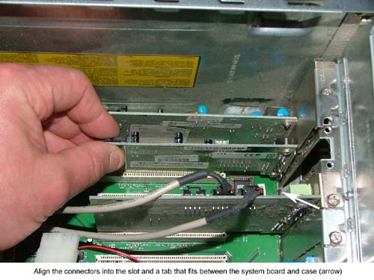
ACTION PLAN JOB
​Job description ​​​ | ​Work required ​​​ | Expected result | Actual result | Constraints ​​​ | Additional remedy ​​​ | ​Comments ​​​ | Time require
Installing NIC cards in the new systems​ | Installation of the network interface card in the new system including correct tools and techniques to install.​ | a correctly installed and working network interface card.​ |  | issues with time because it will stop the use of the machine when installation is being done.​ | ​ | correct tools will have to be used like gloves and wrist bands to be ensured that the motherboard is not damaged in the process of installation.​ | ​​
I installed the Nic card into the PCI slot Oscar started in place.
this is now ready for network connections to be added.
link to source

Slide 14
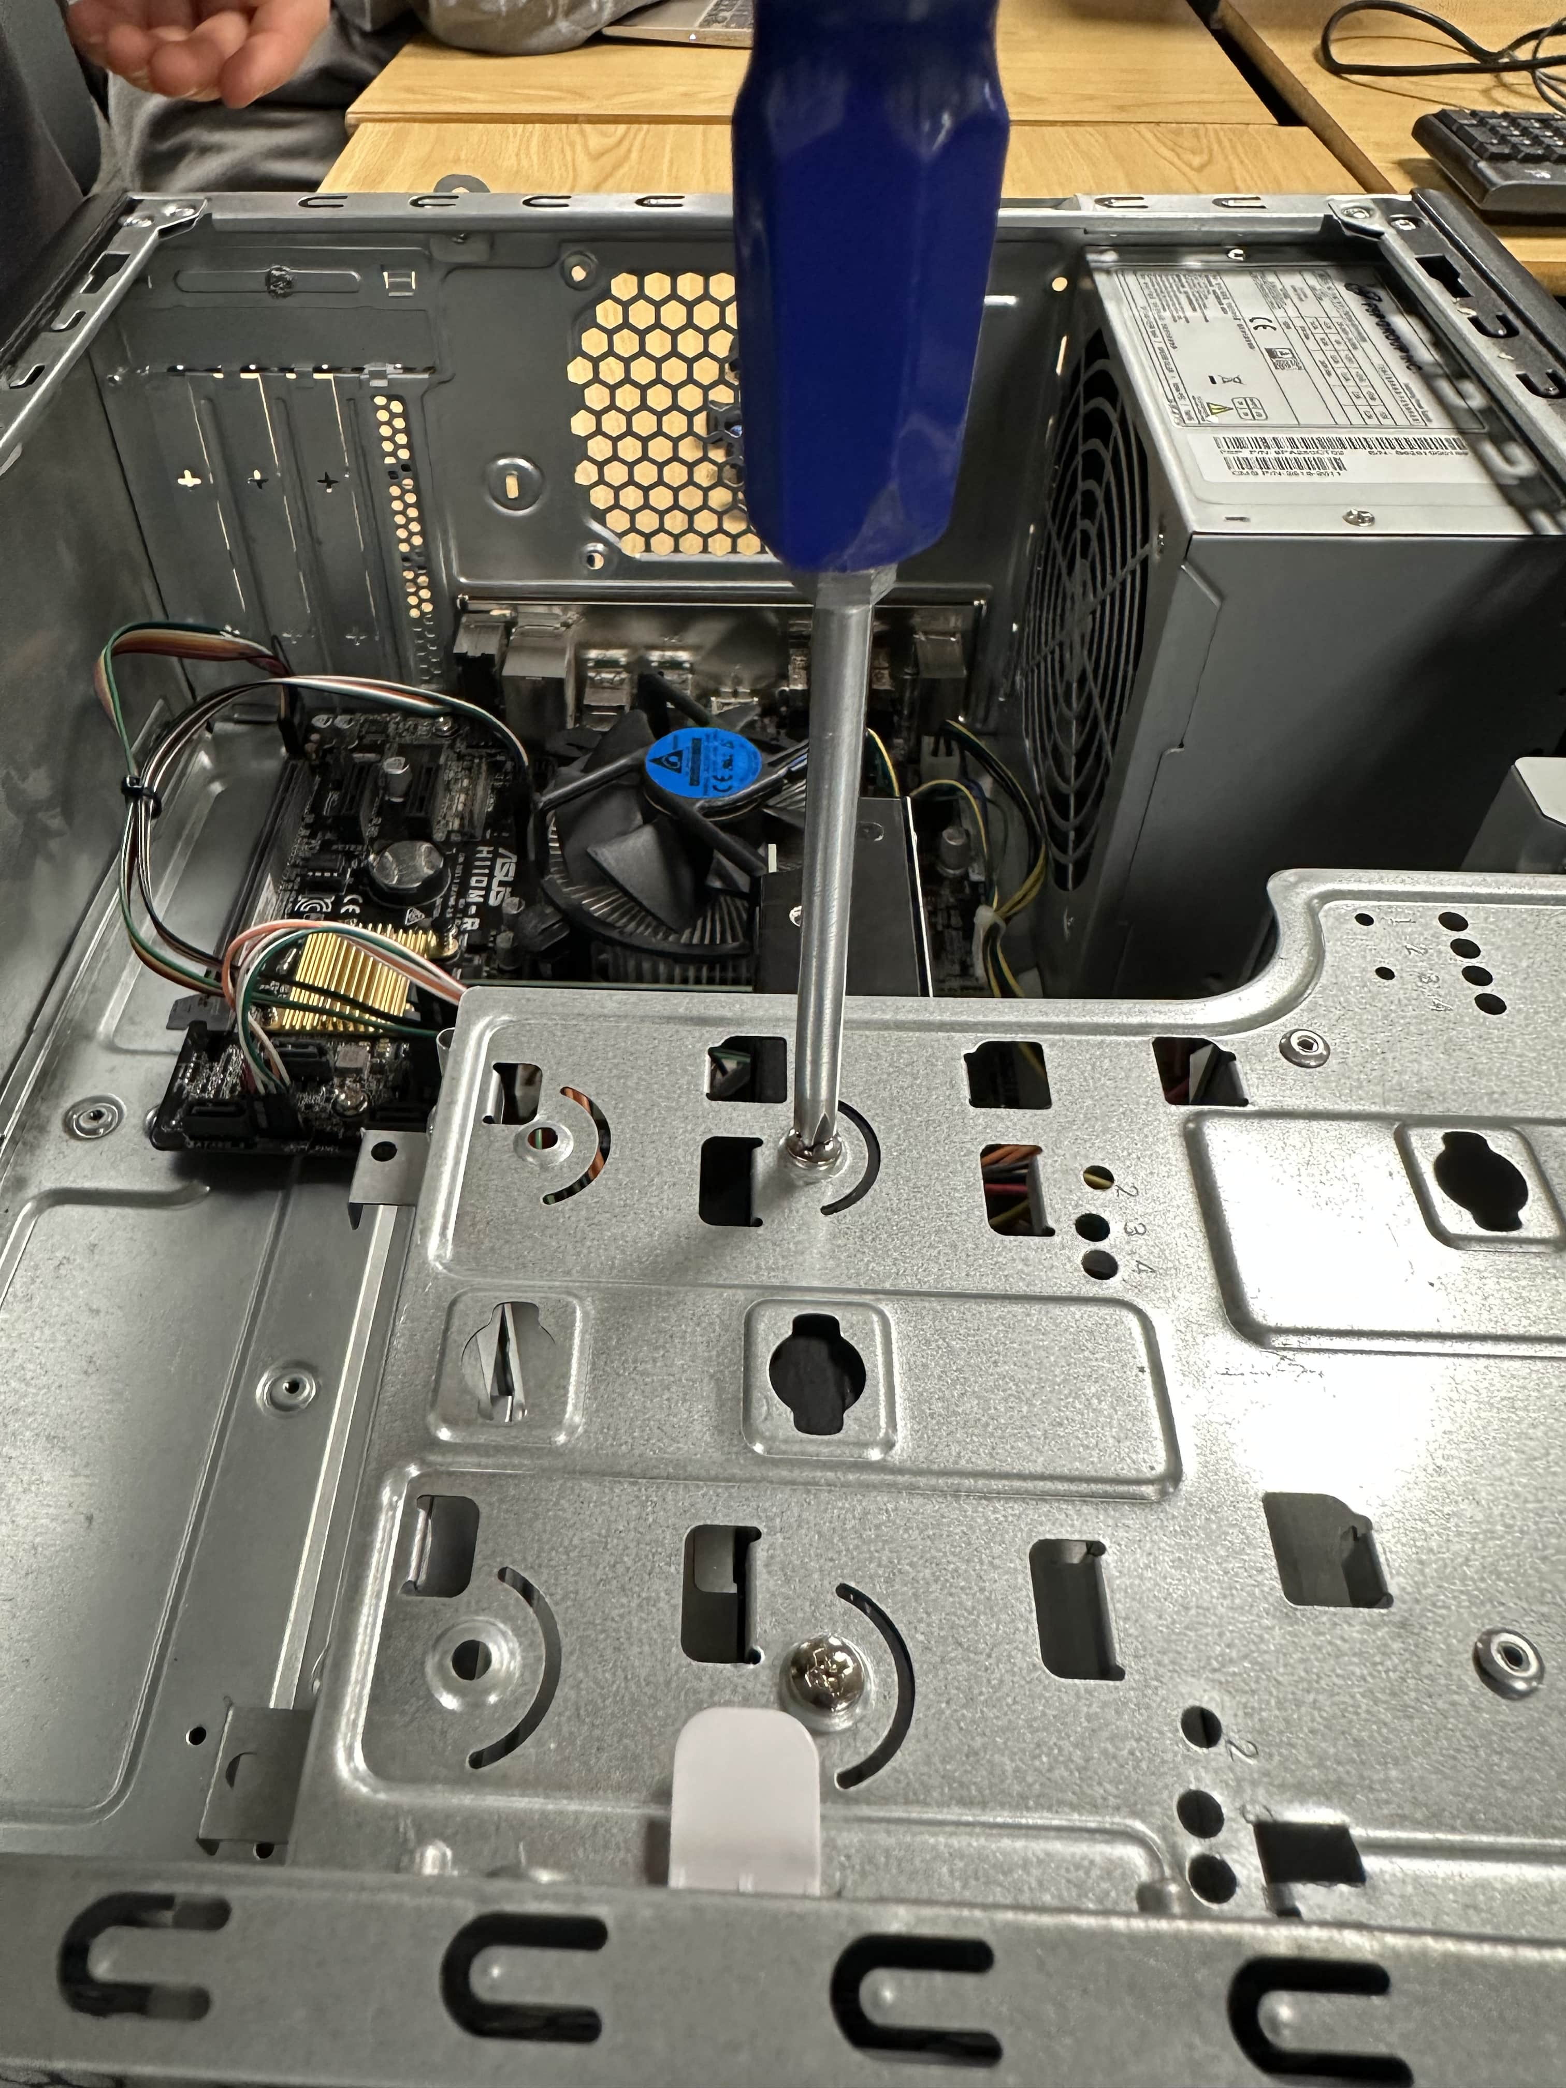
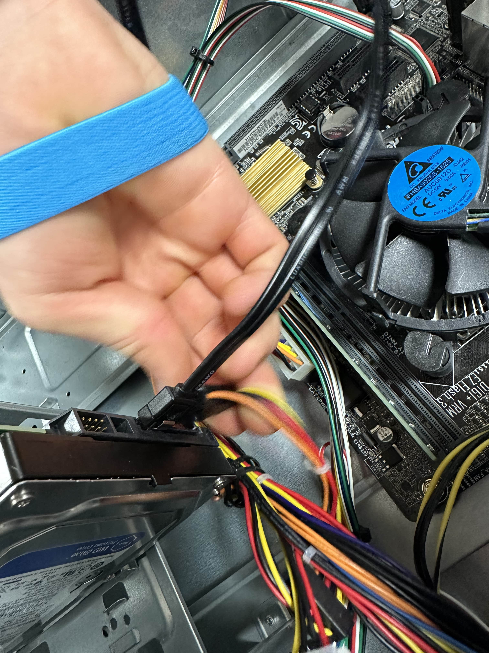
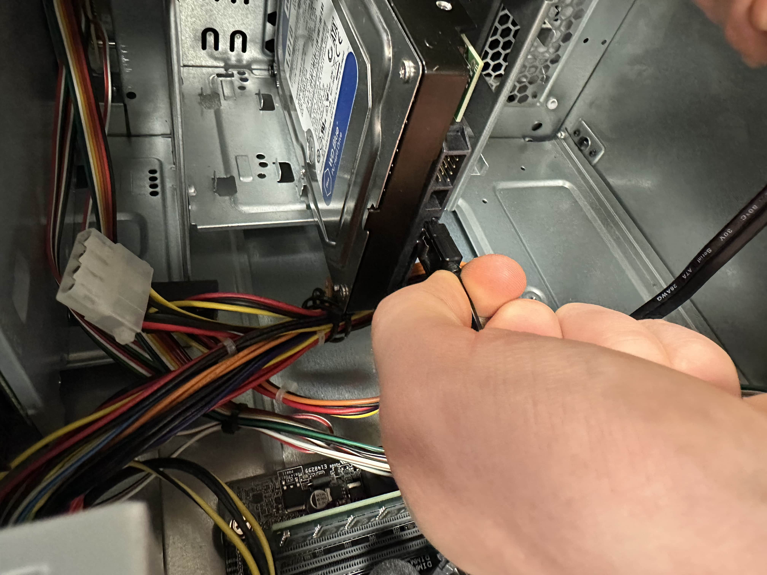
ACTION PLAN JOB
​Job description ​​​​​ | ​Work required ​​​​​ | Expected result ​​​​​ | Actual result ​​ | Constraints ​​​​​ | ​Additional remedy ​​​​​ | ​Comments ​​​​​ | Time require ​​
Installing Hurd drive in ​case​ and connecting the SATA cables. ​​ | ​​ mounting and screwing in the hard drive and connecting the SATA data and power cables to the drive and PC you and motherboard. | ​​ a correctly installed hard drive which can be successfully accessed from the system for storage files and booting OS. | ​​ the drive was successfully installed everything booted perfectly. | ​​ | ​​ | ​​ it is important to make sure these sites I just installed carefully onto the motherboard because bacon be ripped off if they're not handled carefully so training is required. | ​​
Here installed the hard drive and connected it to the motherboard and power supply.

Slide 15
ACTION PLAN JOB
​Job description ​​​​ | ​Work required ​​​​ | Expected result ​​​​ | Actual result | Constraints ​​​​ | Additional remedy ​​​​ | Comments ​​​​ | Time require
installation of new machines.​​ | Installing all components and checking for damages or in cracked installation.​​ | correctly installed components with no damage and working properly.​​ | The machines were all installed and checked with very few problems all went smoothly. | the constraints of this would be that the employers of the company could not work well the new system are being installed so it would have to be done on a weekend, this would be a complicated time schedule.​​ | ​​ | ​​ | ​​
With the installation of the machine new machines, I had to connect the monitors mice and keyboard up to the new computers and check they booted properly, and no more work was required.

Slide 16
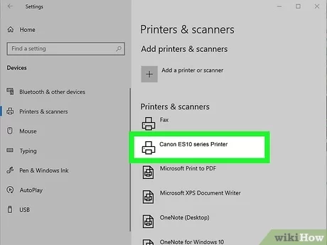
ACTION PLAN JOB
​Job description ​​​​​ | ​Work required ​​​​​ | Expected result ​​​​​ | Actual result ​​ | Constraints ​​​​​ | ​Additional remedy ​​​​​ | ​Comments ​​​​​ | Time require ​​
Installing scanner | ​ I need to add the scanner to the computer as a peripheral device so it can connect. | ​ I would expect the connection with no problems although there could be some things I might need to change in the settings | ​ the scanner connected to all the computers successfully although some needed some persuasion. | ​ the lack of Internet connection made it harder and without network available had to wire it up using Ethernet. | ​​ | ​​ | ​​
I installed these scanner, to do this I needed to connect the computers and scan it together through a switch and then connect them through the settings in printers and scanners and select the right one it can take a few seconds to connect but then I can scan documents onto the computer.

Slide 17
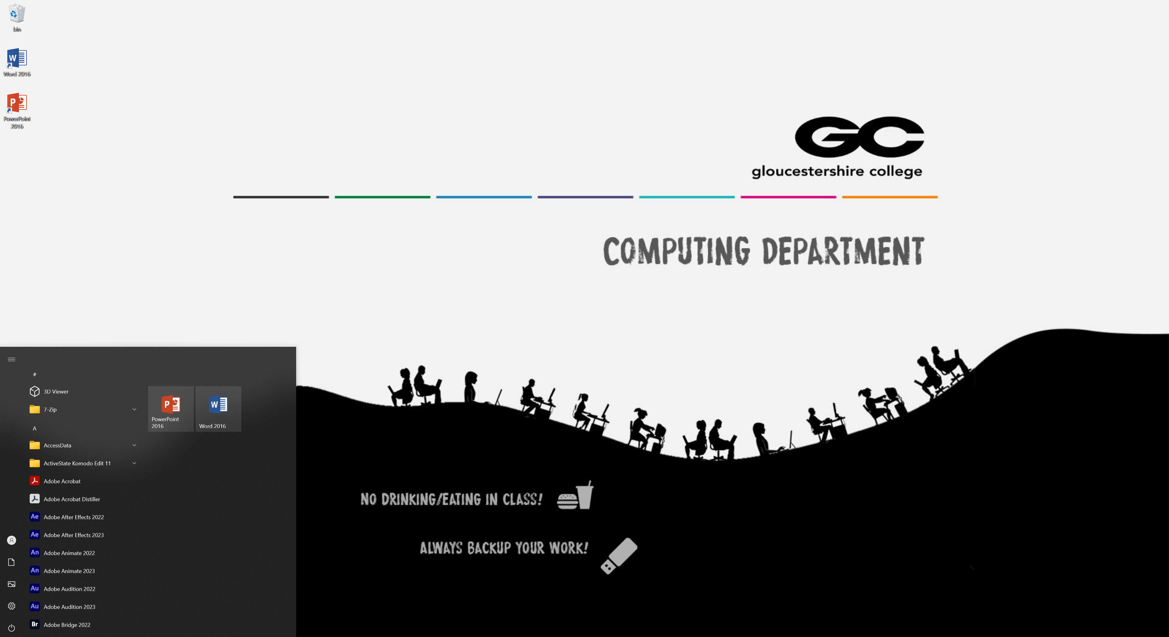
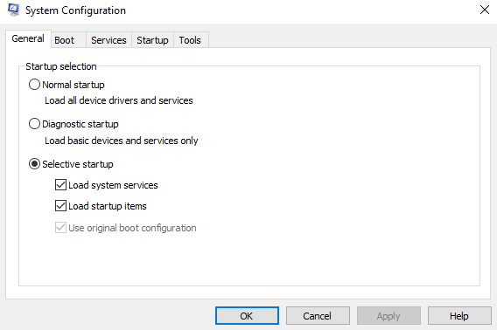
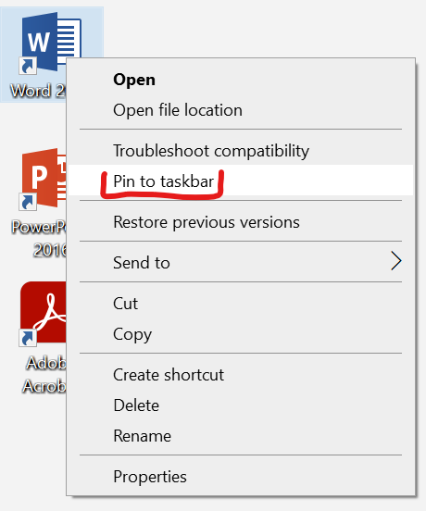
ACTION PLAN job
​Job description ​​​​​ | ​Work required ​​​​​ | Expected result ​​​​​ | Actual result ​​ | Constraints ​​​​​ | Additional remedy ​​​​​ | ​Comments ​​​​​ | Time require ​​
Removing bloatware and customization to software. ​​ | ​​ using Ms. config to remove bloatware and customize the software like shortcuts. | ​ successfully removed bloatware and useful shortcuts for the employees. | ​ I was able to Add all the necessary software's that are used to the taskbar. and I removed all the blood away from the system. | ​​ it can take a while for the system to remove all the bloatware, so I had to leave this for quite a while. | ​​ | ​​ | ​​
If you press windows R and then type in MSConfig you'll open a useful tool for prevent blow away from your drive.
Here I added all the necessary software's that the employees using to the taskbar,
this allows for quicker access to the software the employees are using.

Slide 18
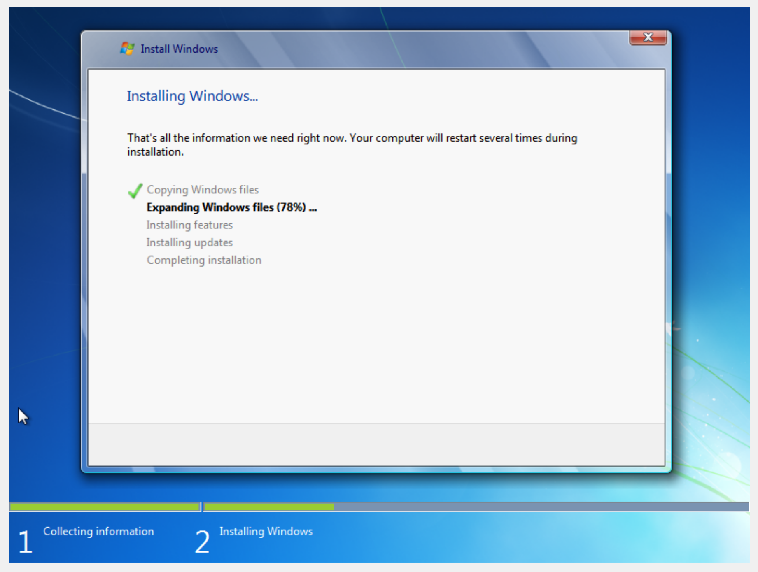
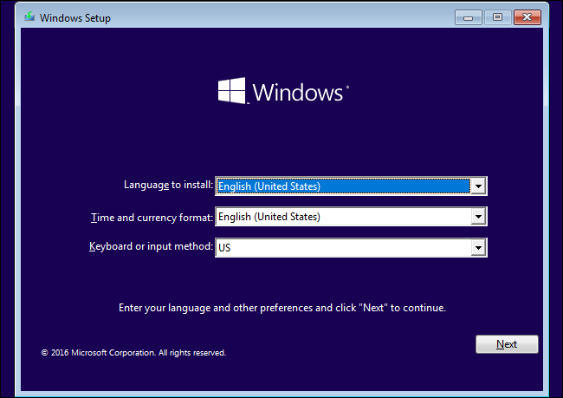
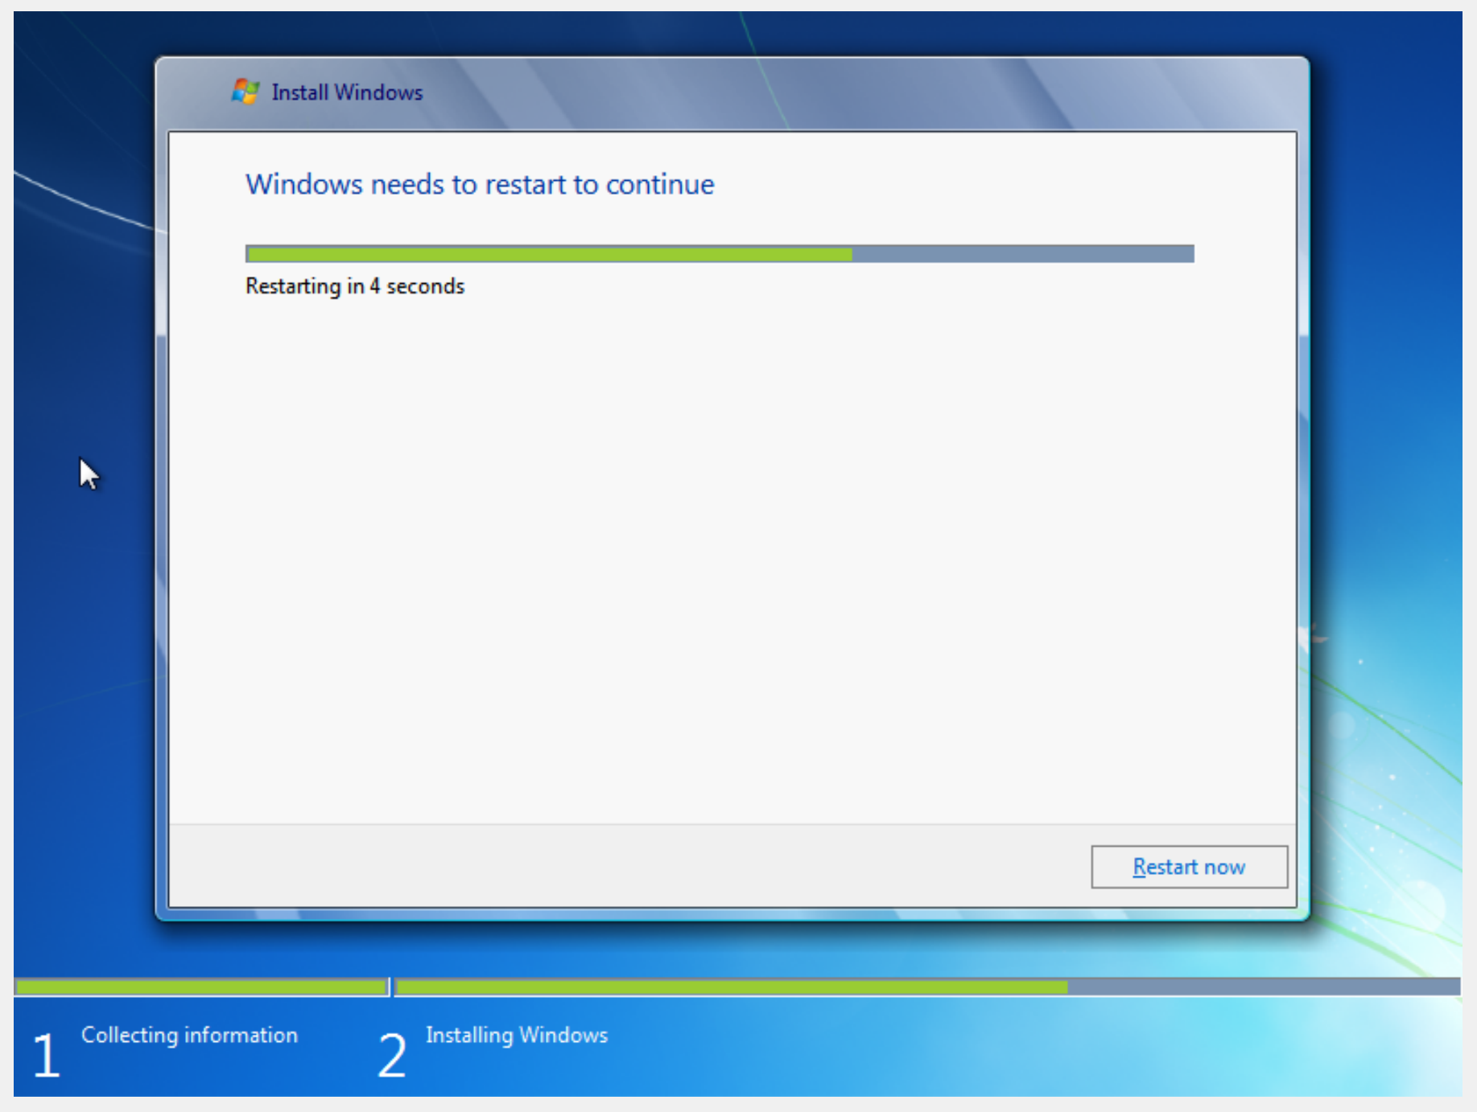
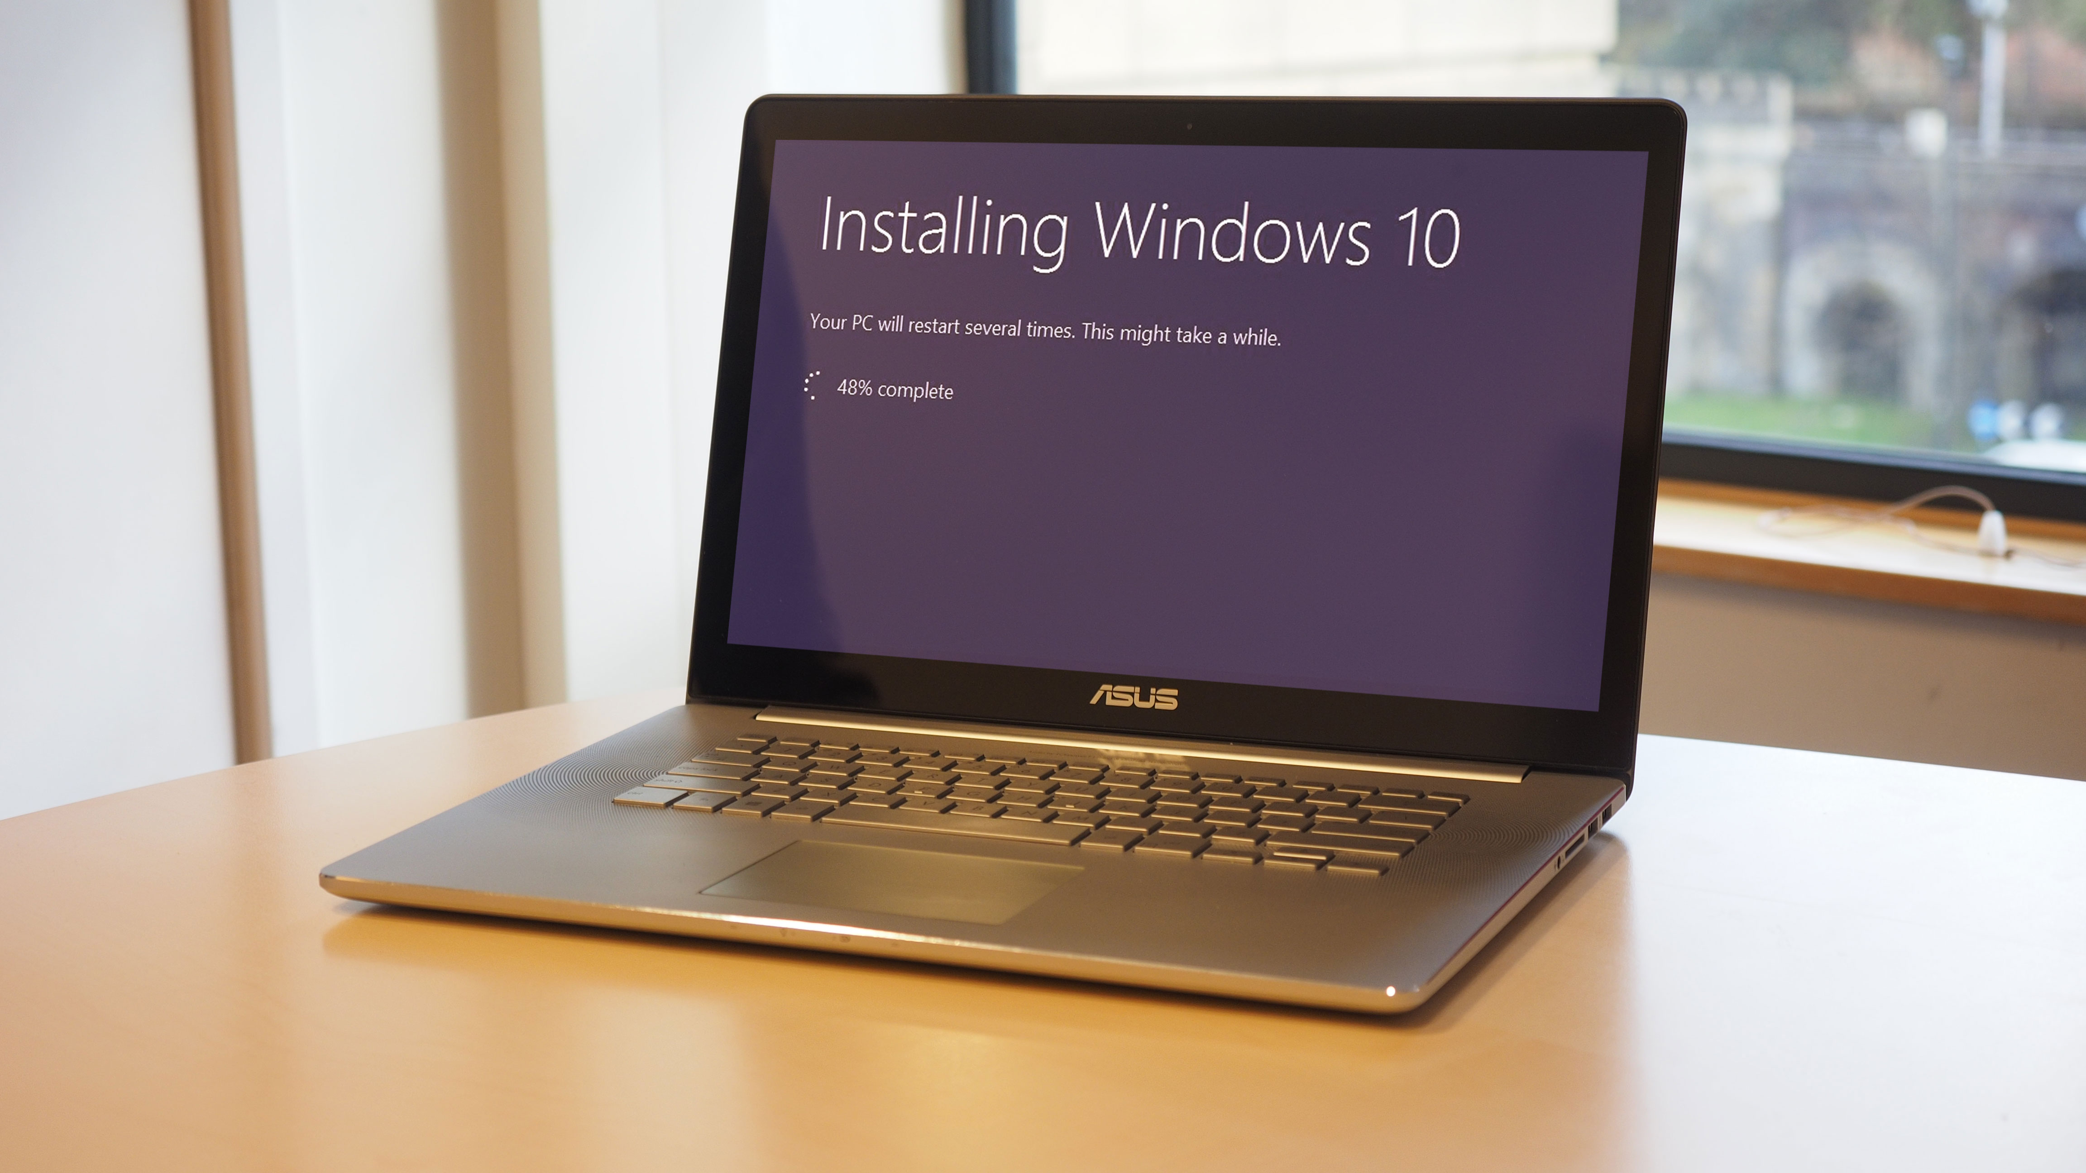
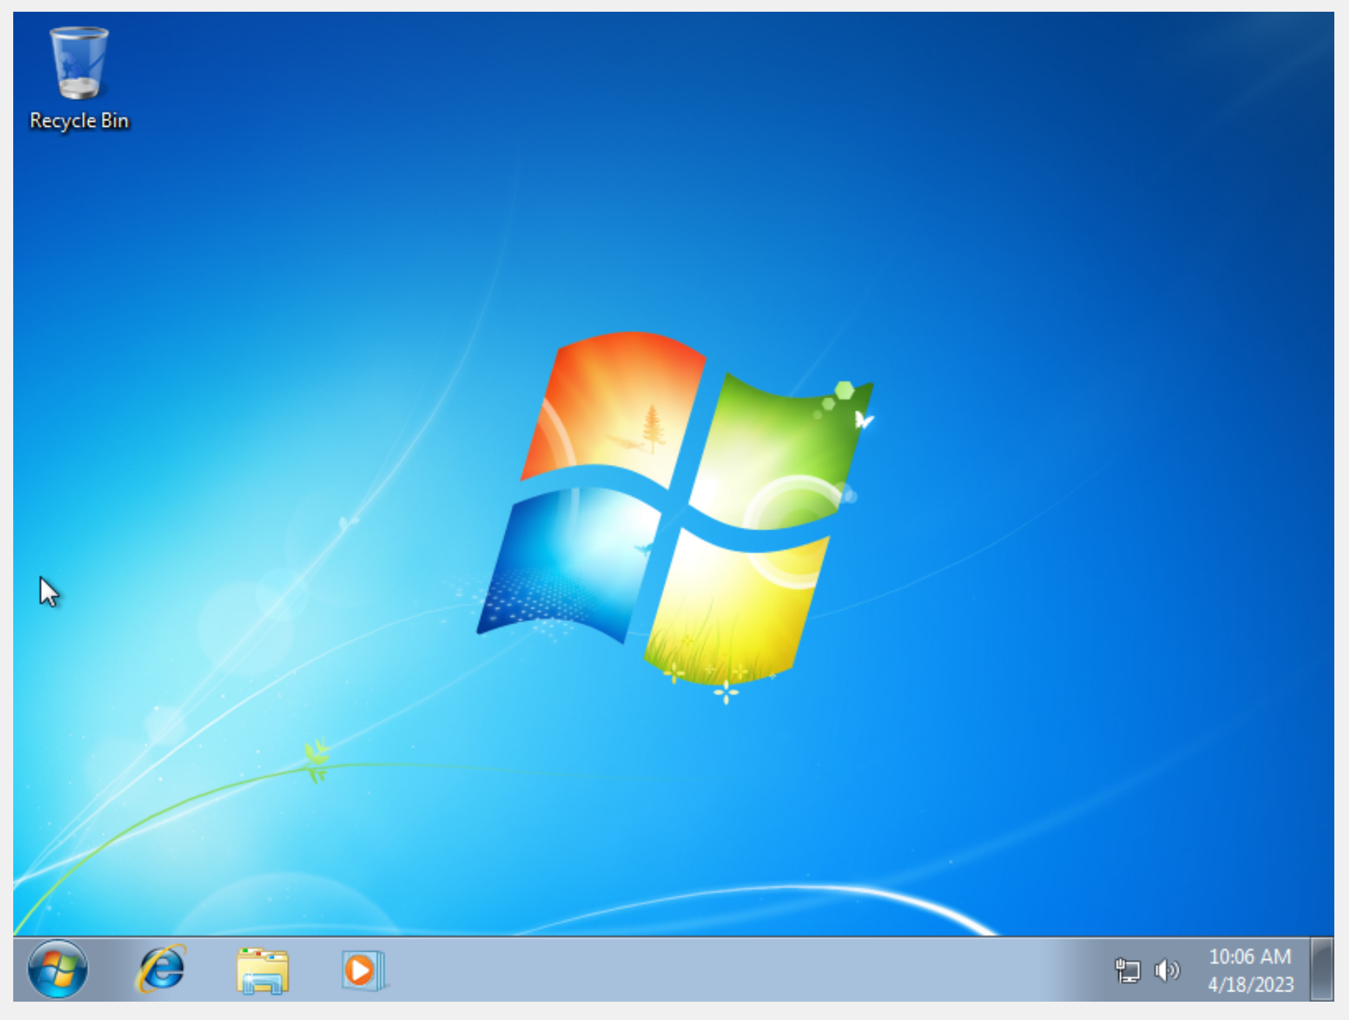
Installing windows
I Installing some of the older systems were still on Windows 7 so I had to update the OS.
link1 link2

Slide 19
Test plan
Test | Item to test​ | How to test​ | Expected outcome​ | Actual outcome​
1​ | CEO's computer​ | Check the installation is correct, and it works​. | I wouldn't expect any problems of this​. | ​CEO's computer was successfully installed.
2​ | The CEO's old SSD drive​ | Check for signs of damage or bad Connexions​ | I would expect some damage to the machine or drive because it shouldn't be broken this quickly​ | There was a faulty connection to the drive, so it wasn't connecting correctly.
3​ | The new computers​ | Check for signs of damage on each component and see if the machine works at the end​ | There should be no damage and the machine should work​ if assembled correctly. | All the components were not damaged and after some small changes all the machines worked perfectly.
4​ | Installation of components​ | Check installation of the components is correct and that they are working​ | I would expect them to work, and I would expect most of them to be installed properly​ | all the components were successfully installed in the new computers there were some minor adjustments to be made on some of them but it all worked perfectly.
5​ | Functionality of software's​ | Open the software and look carefully to see if it works as usual and check there are no abnormal occurrences on the machine when running​ | All software should be running as usual​ | ​ I checked all these software's and they all run normally on the new systems and much faster than on the old systems.
6​ | network interface card​ | see if the devices can be connected to the Internet or each other through a switch​ | There should be no problems with this connexion, it should work perfectly​ | All the Internet connections worked perfectly on all the machines I had to enable the Nic card on a couple other devices but drawing perfectly.

Slide 20
Justification of changes
My justification for any changes or decisions I've had to make with the installation of the systems in Michael page's company.
I can justify reusing the old SSD drives because it considerably lowers the chance of losing company data although I do have backups. All the drives seemed to work perfectly fine so there's no point in getting rid of them and it saves a lot of time not having to reinstalling everything on the new drives.
I just replace all the old systems other than the SSDs, because they were too old to be efficiently upgraded and would very quickly be in need of another upgrade so it's more time and cost efficient to just replaced the entire system.

